Slide 1

Towards a modern grid:
A Clean Electricity Strategy for New Brunswick
By Moe Qureshi, PhD
For the Standing Committee on Climate Change and Environmental Stewardship

Slide 2
The transition in New Brunswick
Following the coal phase-out, the federal government implemented the Clean Fuel Regulations and proposed the Clean Electricity Regulations.
From New Brunswick’s Climate Action Plan 2022-2027
  “Develop a Clean Electricity Strategy by 2025 for achieving net-zero electricity emissions by 2035, based on guiding principles that support clean, reliable, efficient and affordable electricity.”
Notes:
Sets an emissions standard: Any unit must generate electricity that complies with an annual average emissions standard of 30 metric tonnes of CO₂ per gigawatt-hour (30 t/GWh) on an annual basis.
Replacing the Coal phase out by 2030
“Identify the role of renewable energy, including distributed energy that may support the electricity grid, lower peak demand, and provide capacity support.”
This value corresponds to the emissions efficiency of natural gas generation combined with carbon capture and storage (CCS) at a 95% capture rate, a goal that CCS experts and suppliers have verified as achievable by the year 2035.

Slide 3
Conservation Council’s recommendations:
Part 1. Clean Electricity Strategy
Invest in a portfolio approach to electricity with a high priority on renewable energy first, coupled with storage/battery options.
Assess the viability of distributed energy resources (DERs) with smart grid technology.
Increase the build-out of transmission infrastructure such as the Atlantic Loop.
Commission an independent pathway assessment for net-zero scenarios in N.B.
Part 2. Affordability
Address the backlog that NB Power has with the Enhanced Energy Savings Program.
Expand the definition of energy poverty to include social factors.
Part 3. Policy Recommendations
Update and modernize the Electricity Act.
Add “sustainable net-zero mandate” to Energy and Utilities Board Act.

Slide 4
Part 1: Clean Electricity Strategy
Based off N.B.’s Section 68 (b) of the Electricity Act, renewables are the best path forward
(b) be stable and predictable from that all the Corporation’s sources and facilities for the supply, transmission and distribution of electricity within the Province should be managed and operated in a manner that is consistent with reliable, safe and economically-sustainable service and that will:
  (i) result in the most efficient supply, transmission and distribution of electricity,
  (ii) result in consumers in the Province having equitable access to a secure supply of electricity, and
  (iii) result in the lowest cost of service to consumers in the Province, and…

Slide 5
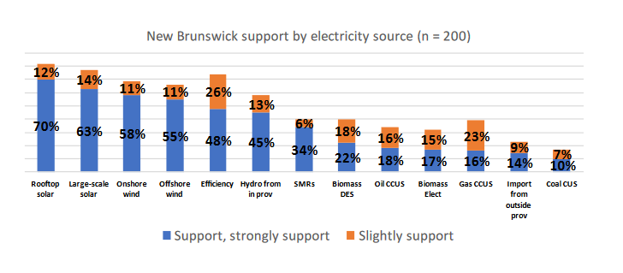
What energy sources should we focus on?
Let’s give New Brunswickers what they want.
Utilities need to make decisions over the next few years about how to supply electricity to customers. Please indicate how strongly you support or oppose the following electricity supply options in your community or region. You'll notice that there is not a sure option, but we encourage you to only use it if you don't have an opinion. Results October 2022: Strongly support, support, slightly support. (Conservation Council of New Brunswick’s national survey on clean electricity regulation).
Notes:
Renewable energy (wind and solar) are abundant in supply, but are they the most cost-effective option?
We need an electricity system capable of keeping us safe in extreme weather events and that doesn’t generate the pollution causing the problem or make other pollution problems worse
Regarding energy security and cost-effectiveness, it is essential to adopt a portfolio approach. This entails prioritizing cost-effective and scalable renewable sources like wind and solar power and dedicating resources to enhance reliability through investments in battery storage to mitigate risks.

Slide 6
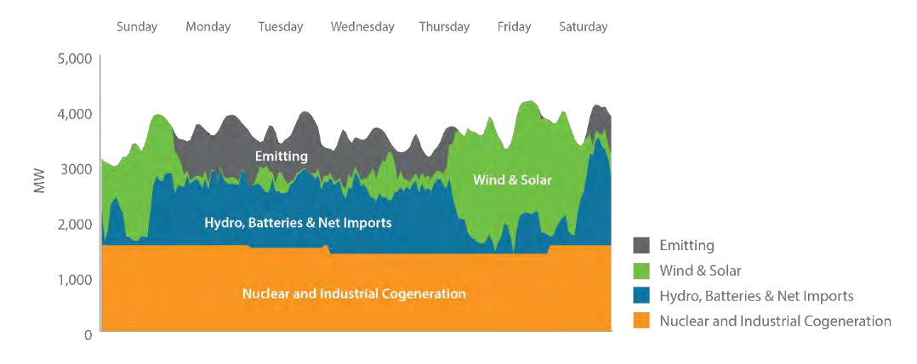
Considering a portfolio approach
From NB Power’s IRP: The hourly energy balance for a week in January 2043 for scenario A (high electrification and rapid-paced technology development scenario)

Slide 7
Prioritize investment in abundant renewable resources
Conservation Council’s recommendation
Year | Newly installed renewable generation (primarily wind) MW | Newly installed storage (primarily batteries)
2025 | 100 | 20
2026 | 200 | 40
2027 | 300 (NB Power’s goal) | 60
2028 | 400 | 80
2029 | 500 | 100
2030 | 600 | 120
2031 | 700 | 140
2032 | 800 | 160
2033 | 900 | 180
2034 | 1,000 | 200
2035 | 1,100 | 220
*With an additional goal of 30 megawatts of solar by 2035 – either residential or utility scale.

Slide 8
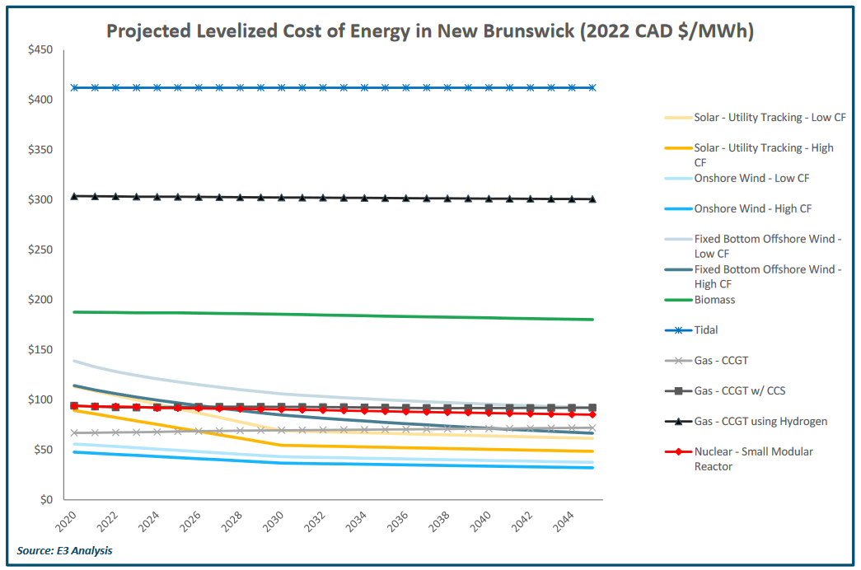

Levelized cost of energy
E3 provided NB Power with data: NB Power Supply Options and Emerging Technologies Study
Concluded “Onshore wind is the least-expensive energy resource today and will be for the foreseeable future”
Energy+Environmental Economics

Slide 9
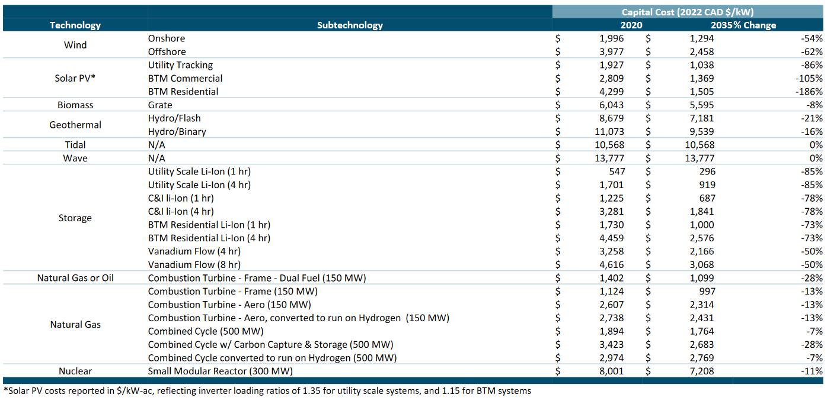
Capital costs
Energy+Environmental Economics

Slide 10
Renewables are cheaper than you think, and they are getting cheaper.
Based off previous slide numbers:
Technology | Capital cost 2020 ($) | Capital cost 2035 ($)
SMR (300 MW) | 2,400,300,000 | 2,162,400,000
For the same price as a 300 MW SMR you could get any of these single options:
 | Technology | MW (2020) | MW (2035)
Option 1 | Wind (onshore) | 1,202 | 1,671
Option 2 | Solar (utility) | 1,246 | 2,083
Option 3 | Storage - Utility Scale Li-Ion (4 hr) | 1,411 | 2,353
Option 4 | Storage - Vanadium Flow (8 hr) | 520 | 705
Notes:
For New Brunswick ratepayers
Push for a portfolio approach prioritizing renewables as they are economically-sustainable

Slide 11
Part 1: Clean Electricity Strategy
Distributed Energy Resources (DERs)

Slide 12


Current electricity system
What happens when something goes wrong?
Single direction transmission
Notes:
NB Power reported a net loss of $43 million in its 2023 annual report, a significant drop from the $80 million profit the year before, primarily due to outages at Point Lepreau and Bayside Generating Station.
One-direction flow
Economies of scale
Historically, NB Power’s financial struggles have been exacerbated by breakdowns at both the Lepreau and Bayside generating stations. NB Power reported a net loss of $43 million in its 2023 annual report, a significant drop from the $80 million profit the year before. In spite of increased revenues from out-of-province sales and higher export prices, NB Power's expenses have risen substantially, impacting its overall financial performance.
Several factors, including the outages at Point Lepreau and Bayside Generating Stations, contribute to this. Point Lepreau has had five outages since 2018, all of which have surpassed budget expectations. During the ten years since the facility's 2012 refurbishment, the Point Lepreau Nuclear Generating Station has experienced over 800 days of lost production due to planned and unplanned outages. From NB Power’s 2022/2023 annual report, Lepreau's production fell to 56.6 per cent of its potential, down from 87.7 per cent the previous year. The Bayside Generating Station experienced a major failure in January 2022, which forced it to go offline. The station then remained inactive for nearly a year, contributing to a supply cost increase of $295 million.

Slide 13


Modern electricity system
A virtual power plant (VPP) is an energy management system that integrates a variety of distributed energy resources (DERs) into a single, co-ordinated entity.
The primary purpose of a VPP is to optimize the generation, storage and consumption of electricity from these distributed resources to meet the needs of the grid, the electricity market or specific consumers.
Bidirectional transmission
Notes:
These resources can include renewable energy sources (e.g., solar panels, wind turbines), energy storage systems (e.g., batteries), and controllable loads (e.g., electric water heaters, electric vehicle chargers).

Slide 14
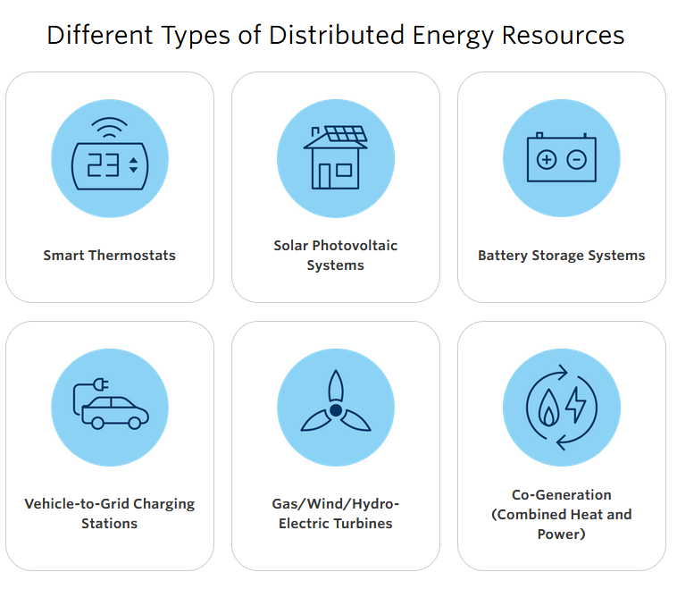
Distributed energy resources are being considered in Ontario
Benefits of DERs:
Provide customers with transparency and control.
Lower system costs.
Provide energy security.
DERs can also incorporate a lot of smart grid technologies.
Chance to modernize rate design (time-of-day, tiered rates, demand response rates, low-income rate design, etc.).
Pilot phase of the Shediac project is currently ongoing (may be considered a DER).
Source: Independent Electricity System Operator (IESO) - Distributed Energy Resources
Notes:
: DERs reduce reliance on the provincial electricity grid by supplying some or all the energy needed for a home, facility or business, which helps lower electricity bills
: DERs can be located close to urban centres, which limits the need for new or upgraded transmission lines
: DERs can be connected to the local or provincial grid, providing back-up power during emergencies
IESO’s Role in Integrating DERs
Locating Ontario’s DERs and driving awareness of how much energy they can provide
Funding research that studies the integration of DERs into the provincial electricity system
Leveraging DERs to drive affordability, reliability and operability
A distributed grid, also known as a decentralized or distributed energy system, offers numerous benefits that contribute to a more efficient, resilient, and sustainable energy infrastructure. Here are some of the key advantages of a distributed grid:
Enhanced Energy Resilience: Distributed grids are more resilient to disruptions, such as natural disasters, cyberattacks, or equipment failures, as they can continue to operate locally even when the central grid is affected. This improves energy reliability for communities and critical infrastructure.
Reduced Energy Losses: Distributed grids reduce energy losses associated with long-distance power transmission. Electricity generated and consumed locally minimizes the inefficiencies that occur during power transmission over long distances.
Energy Equity: Distributed grids can address energy equity issues by ensuring that all communities have access to reliable and affordable energy. They can support underserved areas and reduce energy poverty.
Additional benefits: Increased energy independence, integration of renewable energy, grid decentralization, local economic benefits, environmental sustainability, grid flexibility, technological innovation, more opportunities for demand response and efficiency, easier grid integration of electric vehicles (EVs)
NB Power and Siemens Partnered with more than 400 Shediac homeowners to install and test energy technology that includes solar and battery energy storage systems, and smart thermostats.
Built two of New Brunswick’s first net-zero commercial buildings.
NB Power’s first grid-connected solar farm (1.63 MW) designed to provide clean electricity to the two net-zero commercial buildings with excess electricity flowing into the community via the distribution system.

Slide 15
Part 1: Clean Electricity Strategy
Increase build-out of transmission infrastructure such as the Atlantic Loop
The full benefits of the Atlantic Loop can only be leveraged if combined with in-province renewables.
Build it while it's cheaper. Atlantic Canadian provincial governments should negotiate a better deal with the federal government and take advantage of Budget 2023
Risk of N.B. being left out. New England – Maritimes Offshore Energy Corridor (NEMOEC) published a white paper proposing to build a two gigawatt HVDC connector between Nova Scotia and Massachusetts.
Notes:
Atlantic Loop is not a silo
The estimated capital cost of $6-8 billion USD to build a 2 gigawatt (GW) HVDC connector between Nova Scotia and Massachusetts can be supported through system and greenhouse gas reduction benefits alone, which could deliver upwards of $780m in benefits to the region per year. Economic development benefits, which were not quantified, easily move this proposal beyond break-even into positive value creation.
The reliability and efficiency advantages of connecting these two regions will benefit ratepayers on both sides of the border. Similarly, offshore wind development opportunities in both markets will benefit by reducing revenue risk, socializing transmission costs across a broader set of projects, and substantially minimizing impacts to the environment and other ocean users. We expect these improved commercial conditions to attract more offshore wind development than would otherwise be achieved, which will unlock further cost reductions and ratepayer benefits through economies of scale.
The cost savings associated with consistent application of high-voltage direct current (HVDC) technology provides greater scalability while also enabling some of the key system benefits associated with interregional transmission, such as the ability to dynamically control power flows for bi-directional energy transfer. While alternating current (HVAC) technology can be slightly more cost effective in some circumstances, their larger footprint requirements reduce some of the stakeholder benefits of the proposal and they are unsuitable for development further from shore.

Slide 16
Part 2: Affordability

Slide 17
Part 2: Affordability
Address the backlog that NB Power has with the Enhanced Energy Savings Program
Energy Poverty level in New Brunswick | Total number of Households
High home energy cost burden 6 % + | 114,800
Very high home energy cost burden 10 % + | 47,775
Extreme home energy cost burden 15 % + | 21,270
Low home energy cost burden <3 % | 44,445
Median home energy cost expenditure | $2,776
Notes:
Our job must be to minimize the social, environmental and cost impacts of our electricity
decisions on those who can least afford it
Getting our electricity system decisions wrong puts our citizens at risk, especially if we don’t
aggressively pursue energy efficiency
A deeper understanding of

Slide 18
Part 2: Affordability
Address the backlog that NB Power has with the Enhanced Energy Savings Program
NB Power has received 22,000 registrations since Sept. 28, 2022, for the Enhanced Energy Savings Program (EESP) threshold of earning $70,000 or less.
Currently, there are 16,000 households on the waitlist for this program. The current rate of home retrofits under the EESP suggests it would take well beyond 2025 to reach all the homes on the waitlist.
The provincial government or foundations should fund the development of a grassroots organization network to work with NB Power to get training and help with boots on the ground to implement energy efficiency programs and address the backlog of customers.
NB Power should publish case studies on customers who participated in the program. Include reporting on discrete efficiency metrics such as the amount of money and greenhouse gas emissions saved from switching to a heat pump and increasing energy efficiency in the home.
Recommendations:
Notes:
What happens when you finish addressing the low-income residents???
You can make $85K a year but be a family of 5
this six per cent threshold is an oversimplified approach to identifying those living in energy poverty.
A complete/widely accepted: a comprehensive and accessible program.

Slide 19
Part 2: Affordability
Expand the definition of energy poverty to include social factors
Energy poverty is currently defined as households who spend 6 per cent of their after-tax income on energy bills.
  The reality of the situation is far more complex.
  Certain groups are far more vulnerable than others, such as renters, fixed-income families, rural households, single parents or a household of five with a family income of $80,000.
  Researchers and academics are now taking an interest in energy poverty and recommend using a wide range of indicators.
Recommendation: NB Power and the provincial government should work with institutions like Efficiency Canada, relevant stakeholders and academics to develop a more thorough definition of energy poverty within New Brunswick that looks beyond just the financial aspect and considers social aspects.
Riva, M., Kingunza Makasi, S., O’Sullivan, K.C. et al. Energy poverty: an overlooked determinant of health and climate resilience in Canada. Can J Public Health 114, 422–431 (2023). https://doi.org/10.17269/s41997-023-00741-0

Slide 20
Part 3. Policy Recommendations

Slide 21
Part 3: Policy Recommendations
Raise the energy efficiency investment targets in the Electricity Act (per cent of in-province electricity sales) from 0.75 per cent by 2029 to 1.75 per cent by 2029, based on the 2020 Dunsky report for NB Power and Efficiency Canada’s recommendations.
Raise NB Power’s total in-province electricity sales from renewable resources from 40 per cent to 80-95 per cent by 2035 in the Electricity from Renewable Resources Regulation (NB Reg 2015-60), also under the Electricity Act.
Add an amendment to the Energy and Utilities Board Act to include a “sustainable net-zero mandate.”
Year | Target Reduction | Recommendation
2023/2024 | 0.50 % | 0.50 %
2024/2025 | 0.55 % | 0.75 %
2025/2026 | 0.60 % | 1.00 %
2026/2027 | 0.65 % | 1.25 %
2027/2028 | 0.70 % | 1.50 %
2028/2029 and thereafter | 0.75 % | 1.75 %
Notes:
Currently, the EUB acts as an economic regulator, meaning only the effects of rate impacts are considered for all decisions. The Act should be modernized to include social and environmental concerns while addressing the newly proposed Clean Electricity Regulations by adding a net-zero mandate. This would give more flexibility to NB Power to assess different pathways towards net-zero.

Slide 22
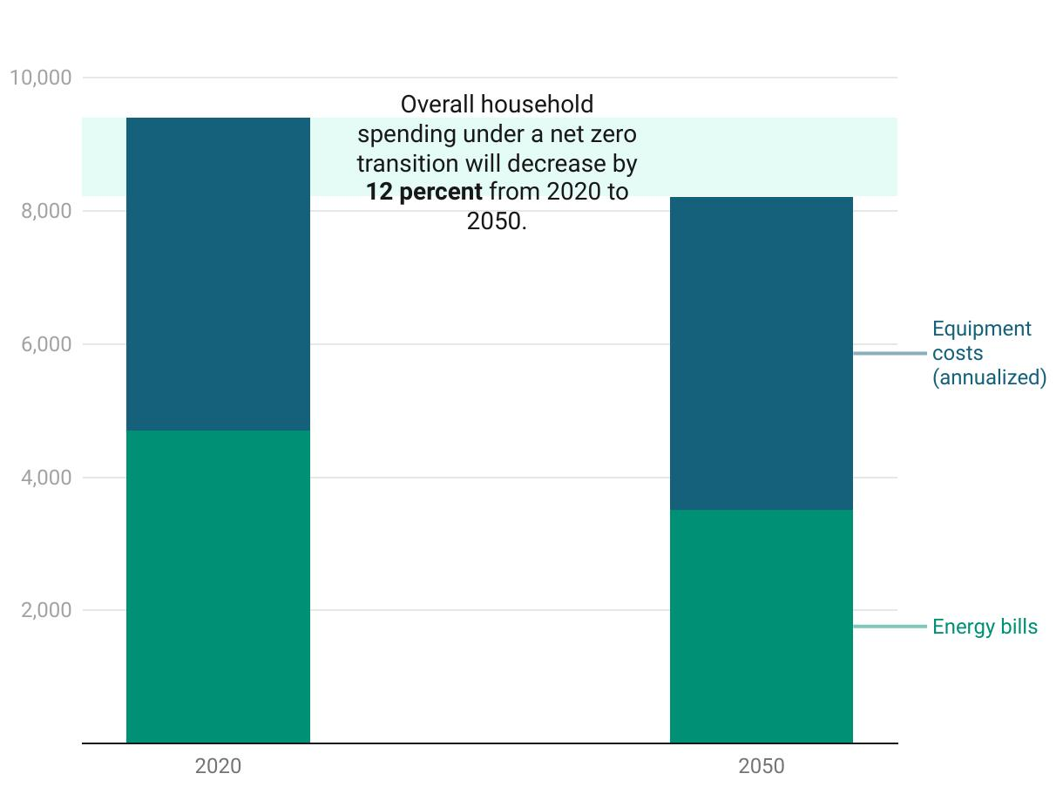
Conclusion
Household spending on energy under a net zero transition (2020 CAD).
Transitioning to a net-zero grid will not only reduce bills but will help address energy poverty, health issues and mitigate climate change.
Canadian Climate Institute

Slide 23
Conservation Council’s recommendations
Clean Electricity Strategy
  Invest in a portfolio approach to electricity with a high priority on renewable energy first, coupled with storage/battery options.
  Assess the viability of distributed energy resources (DERs) with smart grid technology.
  Increase build-out of transmission infrastructure such as the Atlantic Loop.
  Commission an independent pathway assessment for net-zero scenarios in N.B.
Affordability
  Address the backlog that NB Power has with the Enhanced Energy Savings Program.
  Expand the definition of energy poverty to include social factors.
Policy Recommendations
  Update and modernize the Electricity Act.
  Add “sustainable net-zero mandate” to Energy and Utilities Board Act.

Slide 24
CCNB Links
E3 report on “NB Power Supply Options and Emerging Technologies Study”: https://www.conservationcouncil.ca/wp-content/uploads/2023/09/E3-report-for-NB-Power_Costs-1.pdf
Shortcomings in Canadian Regulation of Wood Biomass Used to Generate Electricity: https://www.conservationcouncil.ca/wp-content/uploads/2023/09/ECEL_Report-on-the-Regulation-of-Biomass-Used-to-Generate-Electricity_Public-Distribution-Version_July-2023.pdf
Biomass fact sheet: https://www.conservationcouncil.ca/wp-content/uploads/2022/05/Biomass-Fact-Sheet.pdf
Hydrogen fact sheet: https://www.conservationcouncil.ca/wp-content/uploads/2023/07/Hydrogen-factsheet.pdf
Storage fact sheet: https://www.conservationcouncil.ca/wp-content/uploads/2023/07/Factsheet-Electricity-storage-for-a-reliable-and-resilient-New-Brunswick.pdf
Energy Poverty fact sheet: https://www.conservationcouncil.ca/wp-content/uploads/2023/03/Energy-Povertyin-Atlantic-Canada.pdf
Wind energy reliability: https://www.conservationcouncil.ca/wp-content/uploads/2023/05/Wind-energy-is-reliable.pdf

Slide 25
External Links
NEMOEC white paper: https://nemoec.com/publications/
CCI Canadian households will save money in switch to electricity: https://climateinstitute.ca/new-analysis-finds-most-canadian-households-will-save-money-in-switch-to-electricity/
IESO Distributed Energy Resources: https://www.ieso.ca/en/Learn/Ontario-Electricity-Grid/Distributed-Energy-Resources
IEA Unlocking the Potential of Distributed Energy Resources: https://www.iea.org/reports/unlocking-the-potential-of-distributed-energy-resources
NREL: Using Distributed Energy Resources- A How-To Guide for Federal Facility Managers: https://www.nrel.gov/docs/fy02osti/31570.pdf

