Slide 1

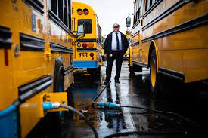
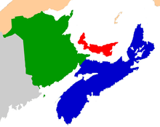

Electric School Buses in the Maritimes
Adam Mahoney, Project Coordinator
Thomas McNeil, Climate Policy Coordinator

Slide 2
Trottier and Echo Foundations
CCNB and EAC are working to mobilize grassroots support and government relations strategies for successful electric bus adoption.
Canada Electric School Bus Alliance (CESBA)
Equitterre, Green Communities Canada, Conservation Council of New Brunswick, Ecology Action Centre, For Our Kids, Pembina, and Pollution Probe.

Slide 3
Panelists
Tomas Murphy, Pupil Transportation Coordinator, Department of Education and Early Childhood Development, New Brunswick.
  Tomas oversees the management of over 1200 school buses and the safety of over 75,000 students who are transported daily by our school buses. Tomas looks after the procurement of new school buses, the training program for new drivers, as well as policy and budgetary responsibilities on behalf of the department.
Mike Franklin, Logistics Specialists, PEI Public Schools Branch
  Mike oversees the training program for electric school buses. He has 22 years of experience in teaching both urban transit operators and school bus operators, as well as 20 years of experience serving in the Canadian Armed Forces as a tank commander.

Slide 4
Why electric school buses?
Diesel exhaust is a human carcinogen.
It causes respiratory inflammation and reduces lung capacity, and it is linked to many other adverse health effects including respiratory effects, cardiovascular effects, central nervous system effects, immunological effects and reproductive and developmental effects

Slide 5

Children feeling sick
Diesel emissions have been estimated to cause 2,200,000 acute respiratory symptom days, 170,000 asthma symptom days and 3,000 child acute bronchitis episodes every year in Canada

Slide 6

Children’s health
Transportation-related air pollutants such as nitrogen dioxide (NO2) and fine particulate matter (PM2.5) are associated with cognitive development disorders in school-aged children (including slower response time, ADHD, anxiety and depression)

Slide 7
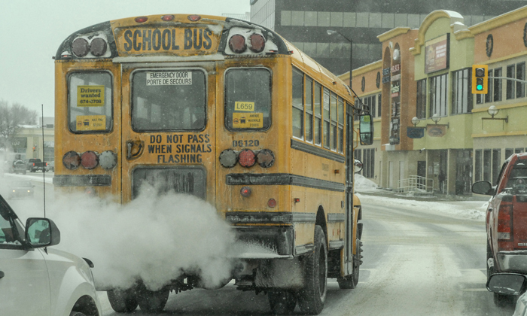
Contributor to climate change
In terms of climate impact, NB’s school bus fleet (around 1,250 buses) emits close to 22,500 tonnes of carbon dioxide (CO₂) per year.
Nova Scotia has more buses (1,298 buses) making their emissions total slightly higher.

Slide 8
Making smart choices for our environment
By shifting to electric, we can help our provinces meet the challenges of climate change.
Approximately 18 tonnes of carbon removed per year for each diesel school bus replaced with electric.
Electric school buses align with NB and NS’ climate goals in their respective climate action plans.

Slide 9

Making smart choices for our children
Substantial reductions in school bus diesel emissions resulted in more than a 30% decrease in childhood bronchitis, asthma case.
(Study published in 2019)

Slide 10

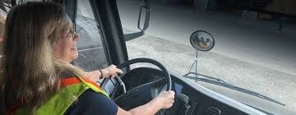
Making smarter choices for our drivers
School bus driver reported how much safer they felt driving an electric school bus given how quiet it was.
Electric buses will also reduce long-term hearing loss experienced by drivers and other diesel related health complications.

Slide 11

Making smart choices to inspire the next generation
The big yellow school buses moving around urban and rural areas are an important symbol of the Maritimes commitment to future generations.

Slide 12
Stakeholder Outreach
CCNB and EAC have been conducting stakeholder outreach to understand the perspective of bus drivers, students, parents, teachers, health experts, and Labour.
We have also been meeting with government departments such as Education and Early Childhood Development, Environment and Local Government, and we are reaching out to Transportation and Infrastructure.
In each instance, stakeholders are enthusiastic about switching to electric school buses. Participants of a recent roundtable on school bus electrification proposed several benefits to adoption.

Slide 13
Stakeholder Feedback
Diesel buses create noise pollution that affect the driver’s ability to pay attention to the road. – Bus Driver

Slide 14
Stakeholder Feedback
“Children’s lungs are less developed and that it is a really critical time to take the opportunity to give them cleaner air, especially on their way to school – you set them up for success.” – Health Expert

Slide 15
Stakeholder Feedback
“[School buses] are a very public symbol of government. Switching to electric shows a clear commitment to a sustainable future and will socialize the next generation of climate conscious residents.” – Parent Stakeholder

Slide 16
Stakeholder Feedback
“In general, the green solution costs less in the end – add on the environmental and health benefits afterwards.” – Teacher Stakeholder

Slide 17
Stakeholder Feedback
“This is a big issue. In the long run it will be cheaper, these buses are an investment in our finances and health. The environment is a priority, and the government has to see that. Electric buses will be reducing CO2 emissions by an amazing amount. We are not investing in electric buses we are investing in a better and brighter future.” – Student Stakeholder

Slide 18
Where to buy E-Buses?
The main manufacturers of E-Buses:
Lion Electric
Blue Bird
Greenpower
Navistar
Thomas Built Buses
Lion Electric is currently hiring for a new facility in Moncton, New Brunswick

Slide 19
Costs of Electric School Buses
Diesel Buses:
Capital Costs: $110,000
Current Fuel Costs: $2.39
Fuel cost after 1 year (20,000km): $17,303
Maintenance cost ($0.19/km): $3,800
TOTAL COST AFTER 1 YEAR: $131,104
After 5 years: $215,518
Electric School Bus:
Capital Cost: $360,000 (150 km range)
Charging Infrastructure: $10,000
Fuel Cost: 11c/kwh
Fuel cost after 1 year (20,000 km): $4,256
Maintenance cost ($0.11/km): $2,200
TOTAL COST AFTER 1 YEAR: $376,456
After 5 years: $402,280

Slide 20
Zero Emissions Transit Fund
In 2021, Government of Canada launched the Zero Emission Transit Fund, investing $2.75 billion to support public transit and school bus operators to transition to zero emission vehicles, from planning to purchasing vehicles and building infrastructure.
50% for capital projects
80% for planning projects
Max of $350 million per project
Fund is running until 2026

Slide 21
Investing in Canada – Green Infrastructure Stream
Electric school bus purchases is eligible under the Green Infrastructure Stream for Climate Change Mitigation – Improved Access to Clean Energy Transportation.
For provincial projects, the stream will fund up to 50% of the costs. PEI has received 50% ($6.3 million) for 2 consecutive purchases of 35 electric school buses.

Slide 22
Payback period with 50% subsidy
Capital Cost: $360,000 (150 km range) + $10,000 charging infrastructure)
WITH FEDERAL GRANT (50% at $185,000):
Fuel Cost: 11c/kwh
Maintenance cost ($0.11/km): $2,200
$60,000 per bus to be at cost parity after year 1
ELECTRIC:
After 1 year: $191,460
After 5 years:$217,280
DIESEL:
After 1 year:$131,100
After 5 years: $215,520

Slide 23
How can CCNB/EAC help make this happen?
Improved children’s health
Improved environmental health
Help NB/NS reach its climate action goals
Take advantage of money available from federal sources
Help the Maritimes make a commitment to transitioning it’s fleet
Joint procurement through CAMET
PEI is already poised to have 25% of their fleet be electric

Slide 24
Thank you
For more information, contact:
Adam Mahoney, Energy and Climate Change Coordinator, Conservation Council of New Brunswick
adam.mahoney@conservationcouncil.ca
Thomas McNeil
Climate Policy Coordinator, Ecology Action Centre
thomas.arnasonmcneil@ecologyaction.ca

