Slide 1
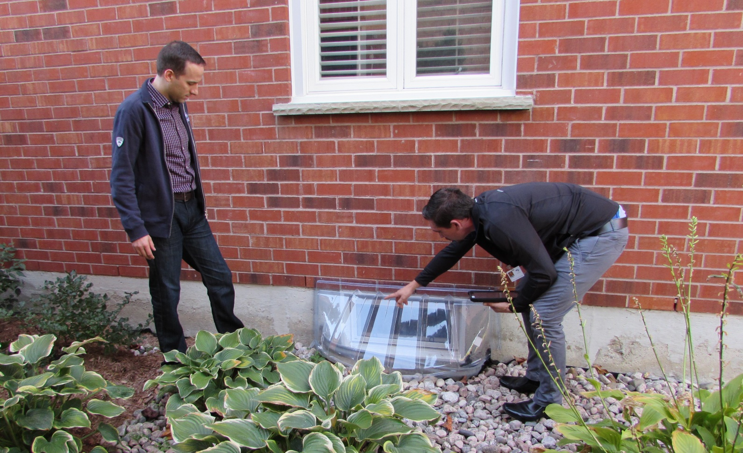
REDUCING FLOOD RISK:
ACTION BEGINS AT HOME
Presentation for:
Nashwaak Watershed Association, NB
February 24, 2021
Presentation by:
Cheryl Evans & Joanna Eyquem
Intact Centre on Climate Adaptation
University of Waterloo
c8evans@uwaterloo.ca
joanna.eyquem@uwaterloo.ca

Slide 2
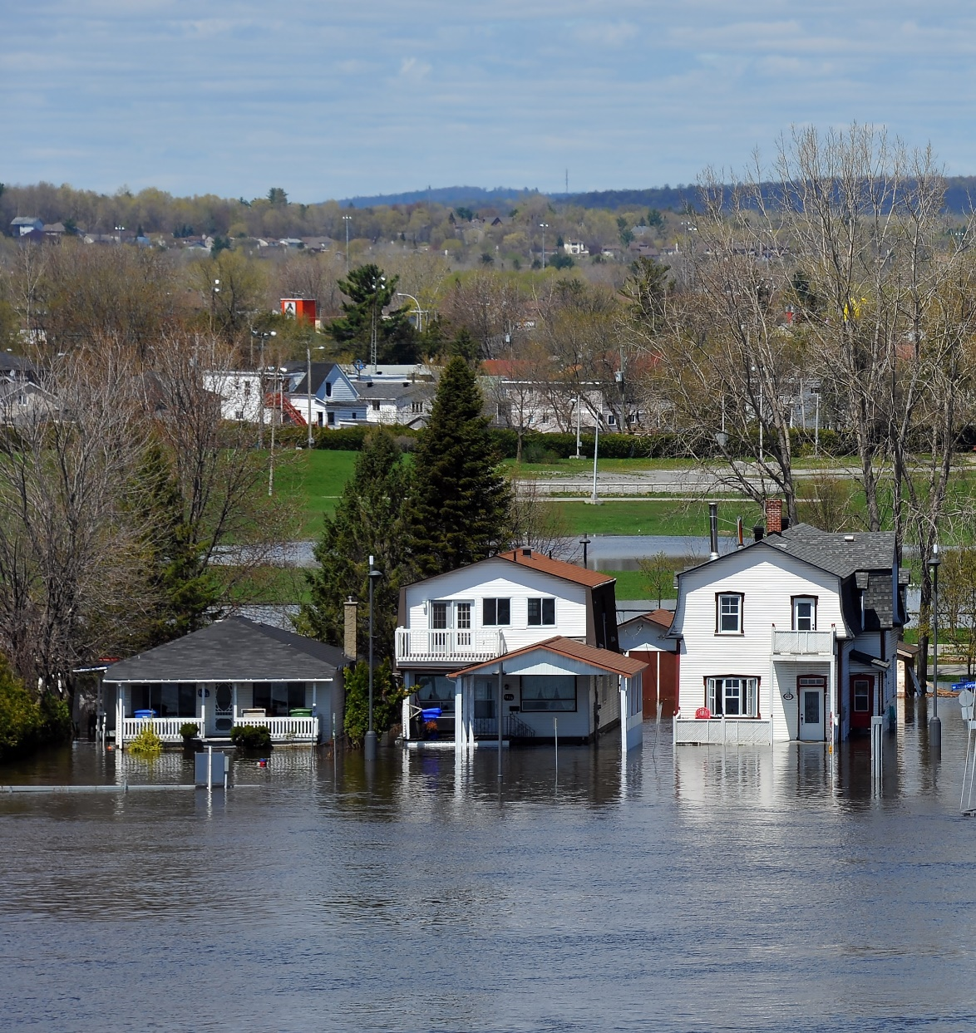
AGENDA
1) Brief Introduction to the Intact Centre
2) Flooding in Canada
  Costs
  Impacts of climate change
  Scales of intervention
3) Strategic Action at the Basin Scale
  Flood risk management in Canada
  Emerging trends
  Flooding in New Brunswick
4) Resident Action at the Home Scale
  Impacts of flooding at the home level
  Addressing common flood risks at the lot level
  Higher risk properties
  Free resources available

Slide 3
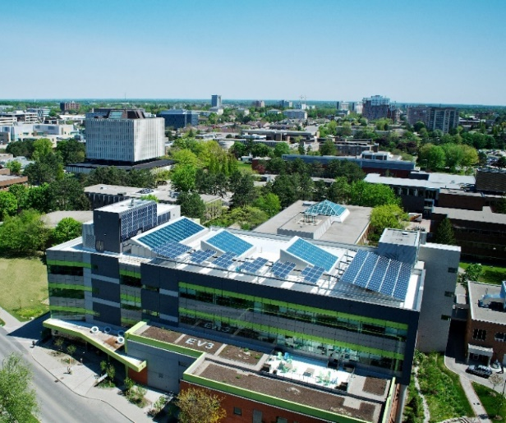
THE INTACT CENTRE ON CLIMATE ADAPTATION
Applied research centre on Climate Adaptation with a national focus
Based at the University of Waterloo
Launched in 2015 with a gift from Intact Financial Corporation*
Bilingual resources
Two main goals:
To change the national conversation about climate change to address climate adaptation
To help residents, communities and businesses to reduce risks associated with climate change and extreme weather events
Intact Centre on Climate Adaptation, University of Waterloo
*The Intact Centre operates independently of all funders and does not benefit from the sale of any products or services.

Slide 4
GETTING TO KNOW YOU
Please go to www.menti.com
Enter the code 38 06 96 4

Slide 5
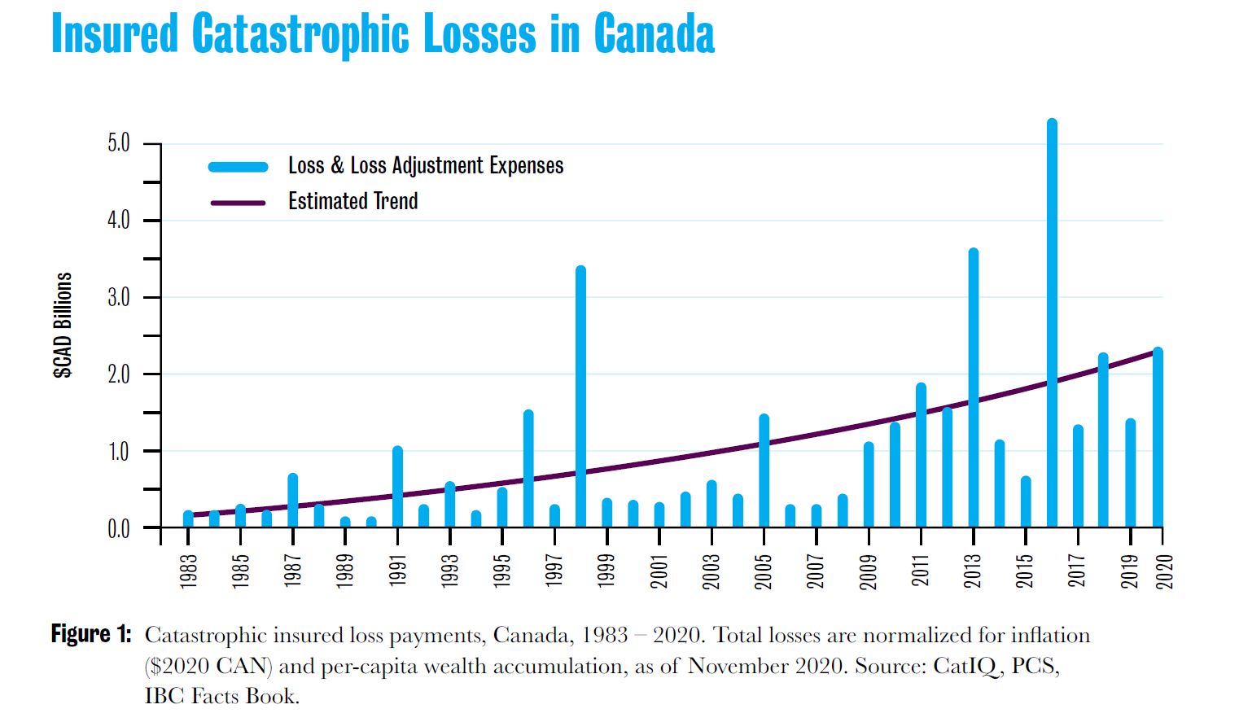
FLOODING IN CANADA: COSTS
Increase largely due to water damage and extreme weather
Uninsured losses of governments and householders estimated at 3 to 4 times these costs
Increase in % of homes that are uninsurable or with low cap limit ($10k-$20k).
Sources : CatIQ , PCS et BAC (Assurances de dommages au Canada).

Slide 6

FLOODING IN CANADA: COSTS
  Health and Safety:
  Physical and mental health
  Major public safety issue
  Direct Costs:
  Rise in insured and uninsured losses, disaster relief payments
  Maintenance costs
  Indirect Costs:
  Lost work hours
  Calgary, 2013: 150 000 to 180 000 people, 2 weeks
    $Half billion dollars of GDP
  Insurance premiums - ↑ 20-25% in 5 years, 15% due to water damage
  Investor confidence:
  Climate change risk being disclosed and being taken into account in investment decisions
  Environmental costs :
  Disruption of « natural » flood patterns
  Impacts on habitats and species

Slide 7
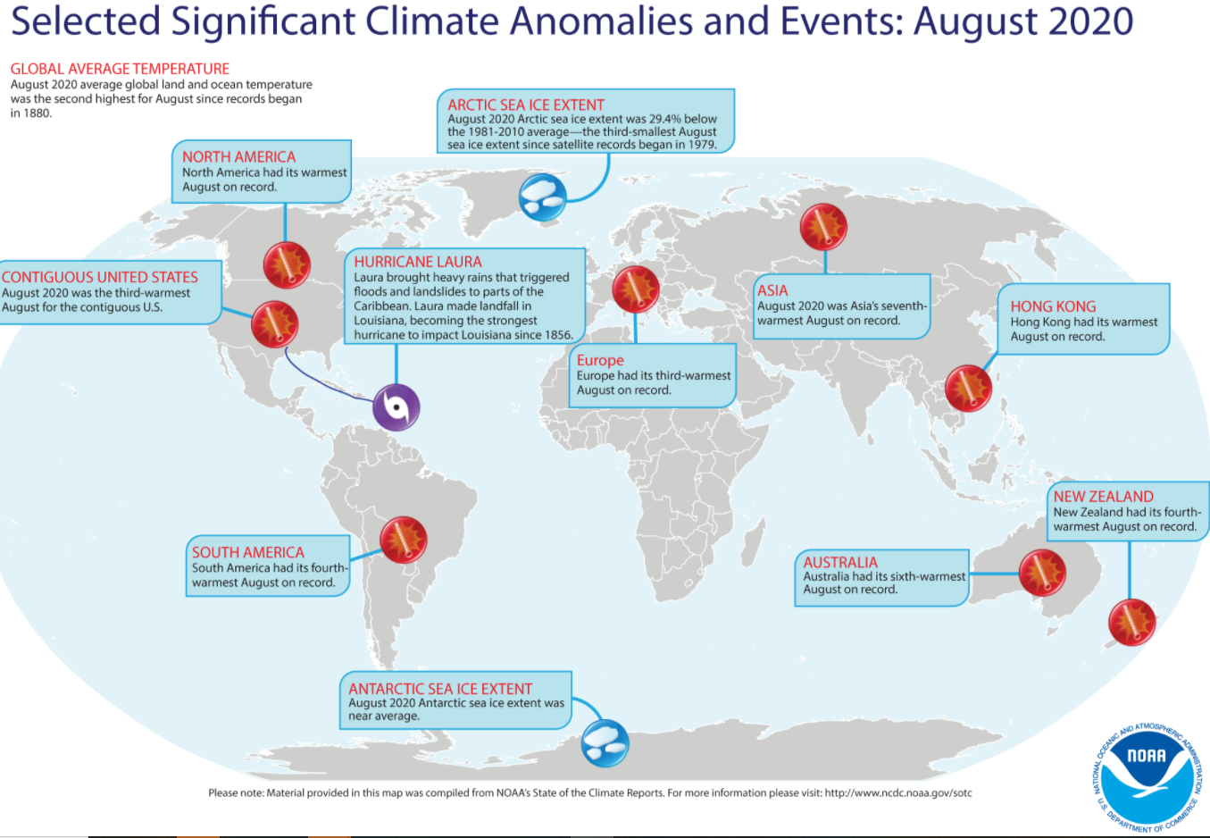
CLIMATE CHANGE IS REAL AND EFFECTIVELY IRRIVERSIBLE
2020
August the hottest EVER documented in North America
9 / 10 of the hottest years globally are in the last decade
(the 10th is 1998)
Source: NOAA State of the Climate, 2020
https://www.ncdc.noaa.gov/sotc/

Slide 8
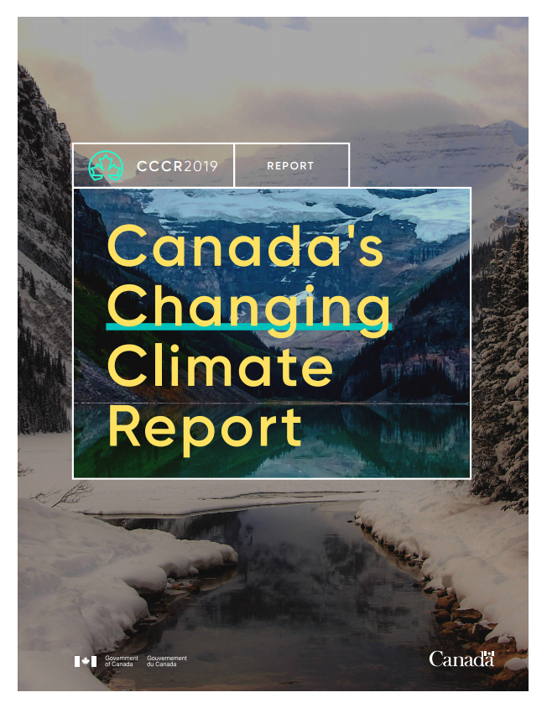
CANADA’S CHANGING CLIMATE
Canada’s climate has warmed and will warm further in the future, driven by human influence.
Both past and future warming in Canada is, on average, about double the magnitude of global warming.
Warming is effectively irreversible.
    Climate Impacts
    More extreme heat / less extreme cold
    Shorter seasonal coverage of snow and ice
    Melting of glaciers and permafrost
    Rise in sea level
  Intensification of certain extremes
    Intense rainfall and urban flooding
    Coastal flooding
    Severity of heat waves
    Risk of drought and forest fire

Slide 9
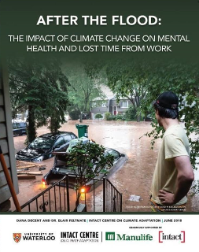
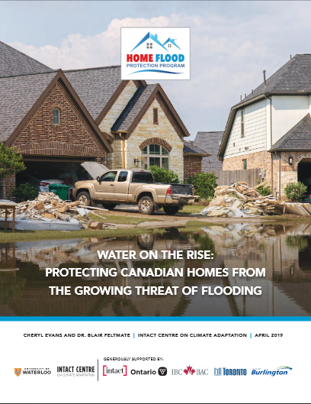
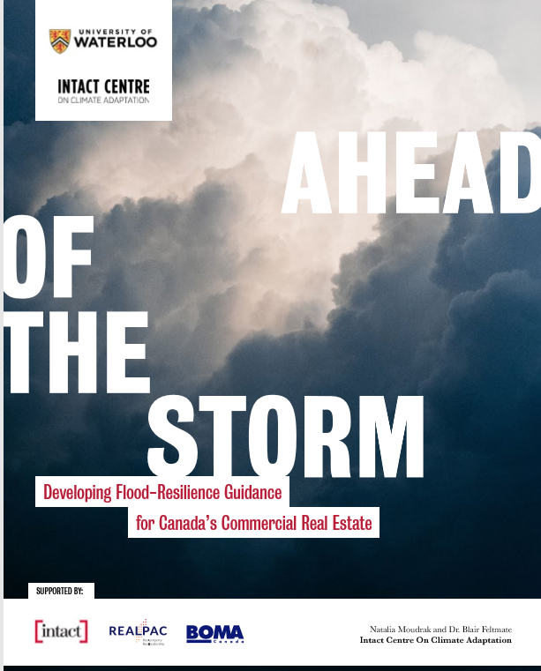
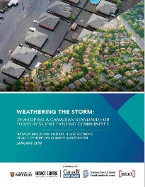
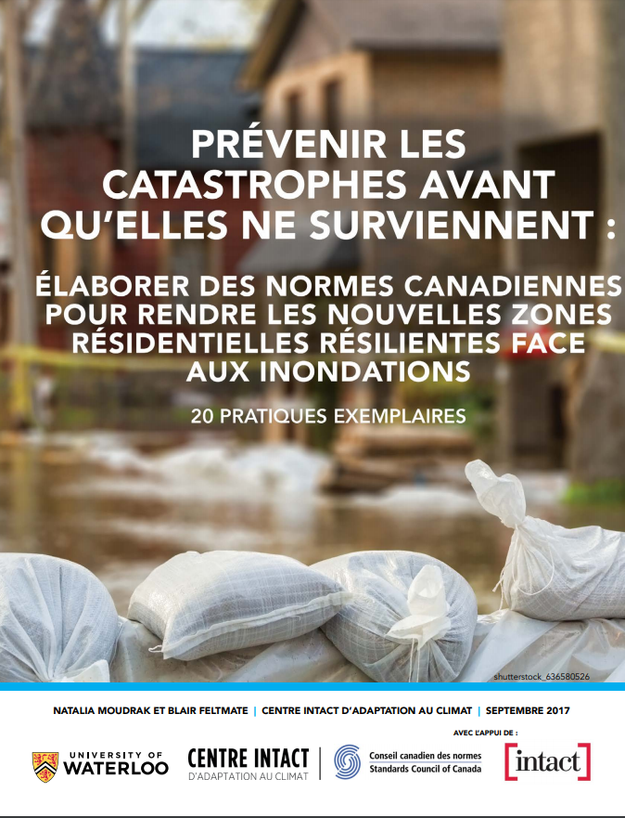
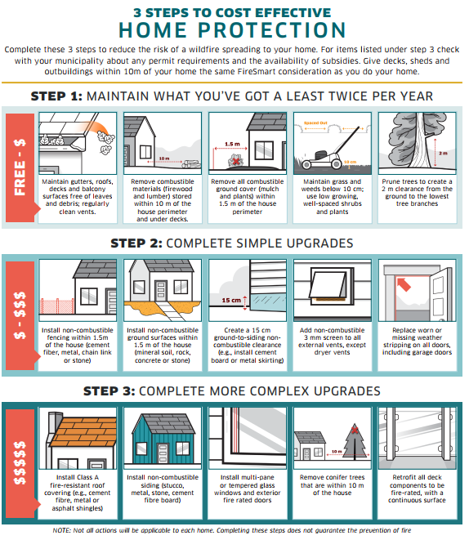
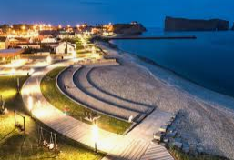


ADAPTING TO REDUCE RISK
Development of national guidelines and standards to reduce climate risk
Flooding
Citizens
Homes
Commerical Real-Estate
Existing Communities
New Communities
Other Risks
And under-utilized approches to reduce risk…
Forest Fires
Coastal Erosion
Role of Natural Infrastructure
Application of TCFD
Notes:
Understanding the need to reduce risk working at different levels, the Intact Centre on Climate Adaptation has developed a series of reports, guidelines and standards.
Flooding
Other risks – forest fire and coastal resilience
We are also considering tools that are currently under-utilized in tackling climate risks.
Natural Infrastructure
Financial sector and capital markets
Hand over to Kathryn

Slide 10





FLOOD RISKS: ADAPTING AT DIFFERENT SCALES
Emerging
Canadian Focus
INVESTMENT FRAMEWORK
TIME / COMPLEXITY
RIVER BASIN / COASTAL CELL
COMMUNITIES
BUILDINGS
Residential and Commercial
INDIVIDUAL
SPACE
*Icons from “Calgary – Flood Resilience Plan”
Source: https://www.calgary.ca/uep/water/flood-info/mitigation-and-resilience/flood-projects.html

Slide 11
AGENDA
1) Brief Introduction to the Intact Centre
2) Flooding in Canada
  Costs
  Impacts of climate change
  Scales of intervention
3) Strategic Action at the Basin Scale
  Flood risk management in Canada
  Emerging trends
  Flooding in New Brunswick
4) Resident Action at the Home Scale
  Impacts of flooding at the home level
  Addressing common flood risks at the lot level
  Higher risk properties
  Free resources available

Slide 12
FLOOD RISK MANAGEMENT IN CANADA
Responsibility with provincial government
  Often delegated to local governments or river basin authorities
  Federal government provides guidance
Funding through different streams
  Federal Disaster Mitigation and Adaptation Fund (match funding)
  National Disaster Mitigation Programme
  Federation of Canadian Municipalities
  Provincial funding
Action largely at the community scale
  « Patchy » flood risk mapping - mainly river focused
  Site-specific flood protection / use of largely engineering approaches
  Limited systems thinking
Movement to look at the strategic river basin scale
  Ontario Conservation Authorities and « Natural Hazard Lands »
  Quebec - Bill 67, Freedom Space
  National Adaptation Strategy
Use of Natural Infrastructure
  Valuing of ecosystem services
  Multidisciplinary approaches
  Natural asset management
Private Sector Engagement
  Climate risk disclosures
  ESG performance
  Investment in resilience and natural capital

Slide 13
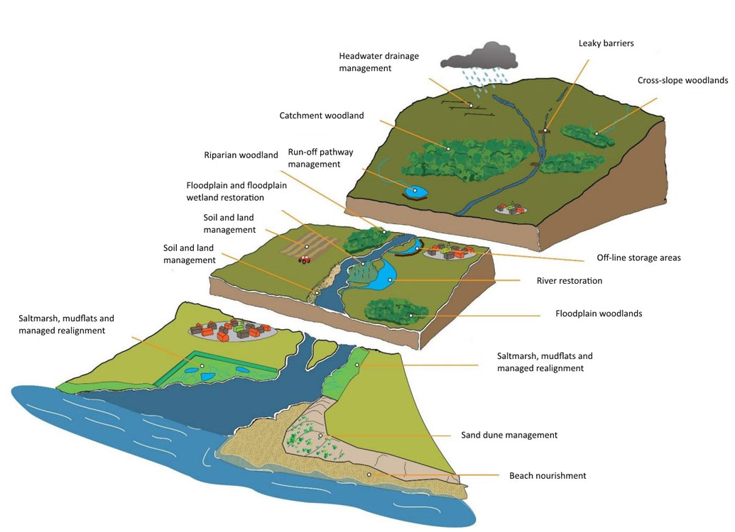
EMERGING TRENDS: RIVER BASIN APPROACH
Increase storage
Increase roughness
Increase losses (infiltration, evapo-transpiration)
De-synchronise peak flows
Reduce soil and river erosion
Work with natural processes
Multiple benefits and ecosystem services
Source: Catchment Based Approach (2020) What is Natural Flood Management? https://catchmentbasedapproach.org/learn/what-is-natural-flood-management/

Slide 14
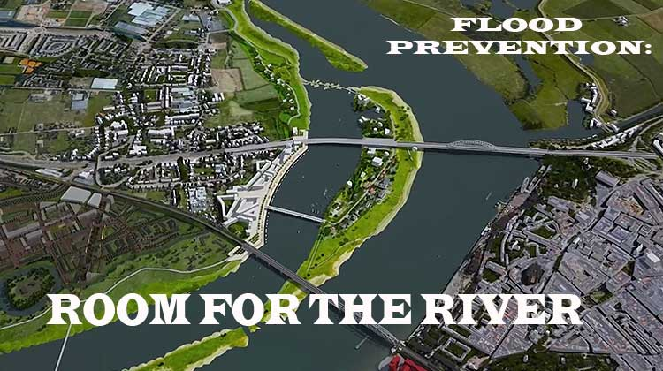
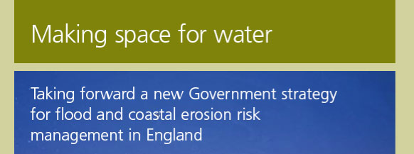
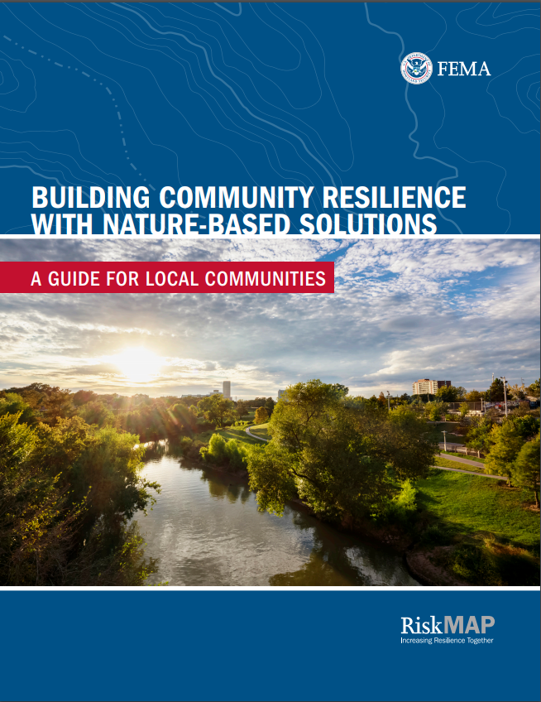
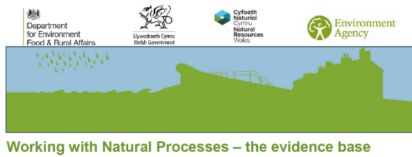
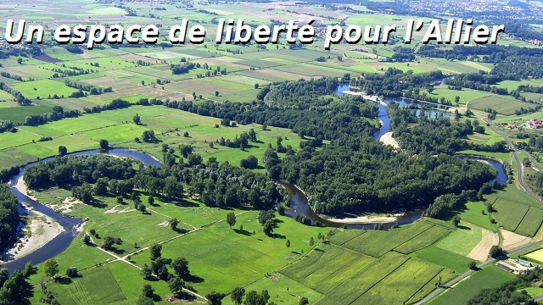
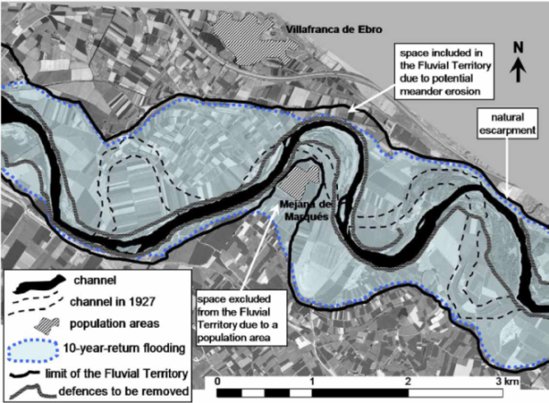
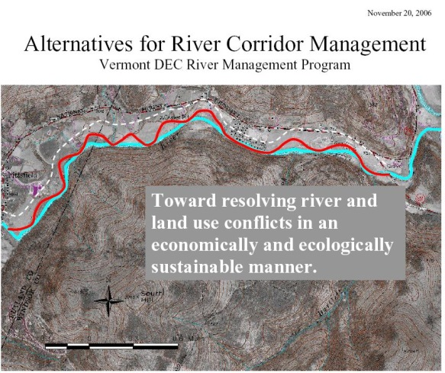
EMERGING TRENDS: WORKING WITH NATURAL PROCESSES
Flood risk based “room for the river”…
And “erosion room”…
Netherlands, 2000
UK, 2004
USA
Fluvial territory
Using nature based solutions…
France
Spain
Vermont

Slide 15
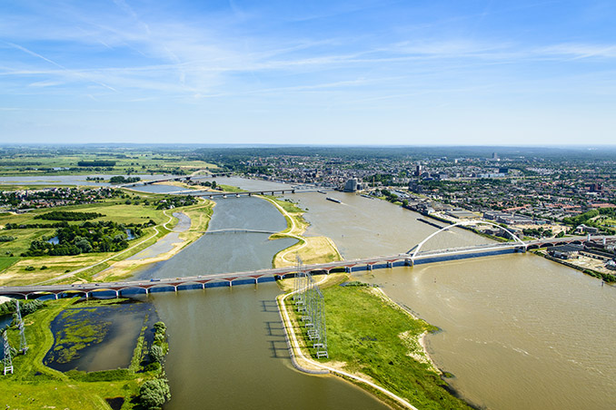
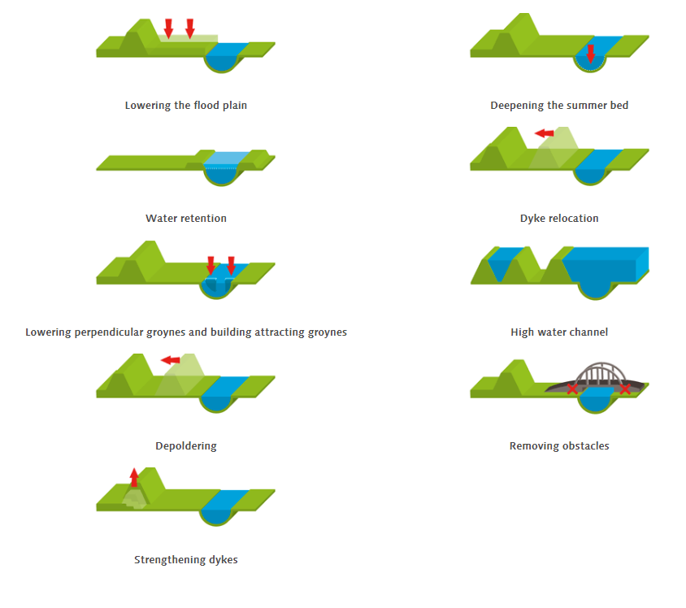
‘ROOM FOR THE RIVER’, THE NETHERLANDS
30 key sites
https://www.ruimtevoorderivier.nl/english/

Slide 16
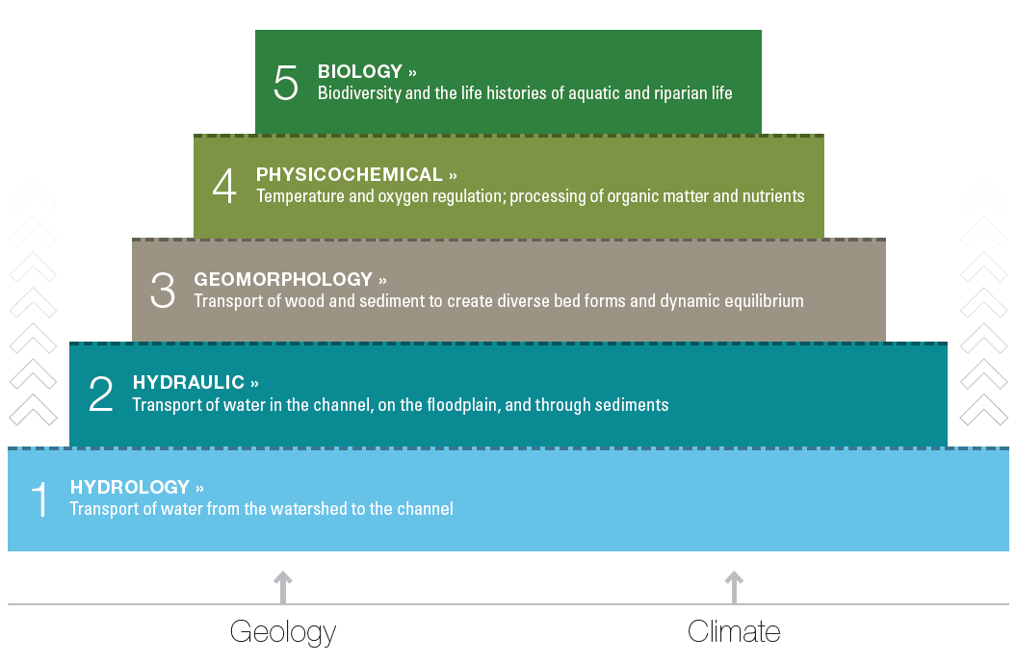
EMERGING TRENDS: MULTIDISCIPLINARY APPROACH

Slide 17
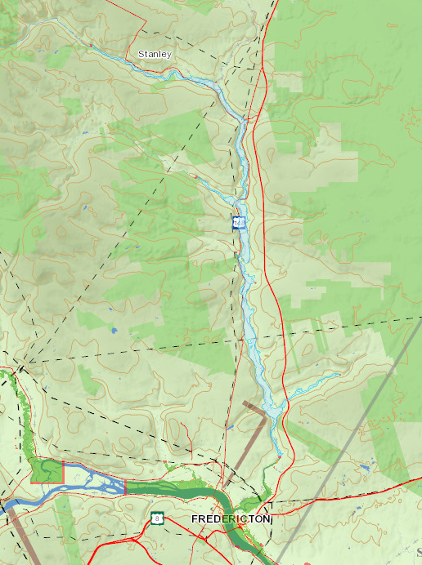
FLOODING IN NEW BRUNSWICK
The Triple Whammy
Riverine flooding:
  St John River 2018 and 2019
  60,000km of river in the province
  Nashwaak Watershed – river mouth (back up of St John River), Penniac, Nashwaak Bridge, and Stanley
  Ice jams
Coastal flooding:
  Impacts of sea level rise and high tides
  Hurricanes – e.g Arthur and Dorian
Intense rainfall flooding in urban areas:
  Increase with climate change
“The removal of forests along the lower floodplain of the Nashwaak has greatly reduced the river’s ability to control the amount and timing of flood waters and floods...”
(NWAI, 2017).
Sources: Nashwaak Watershed Association, State of the Watershed
https://www.nashwaakwatershed.ca/wp-content/uploads/SotW_summary_ENG_FINAL_highres-1.pdf
Province of New Brunswick GeoNB portal – Flood Information,
https://geonb.snb.ca/geonb/

Slide 18
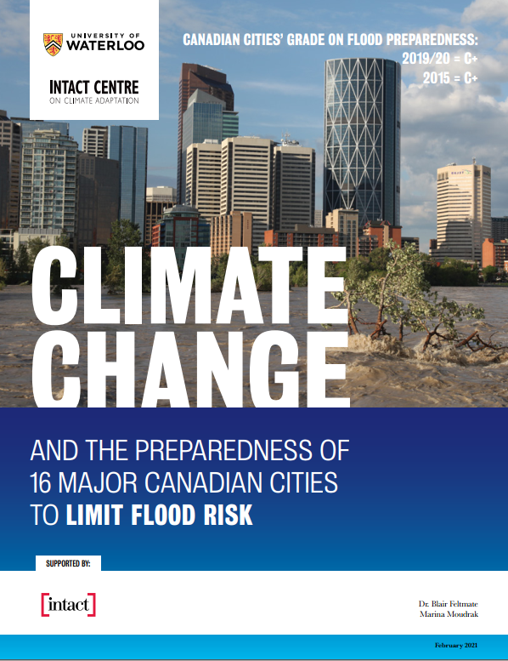
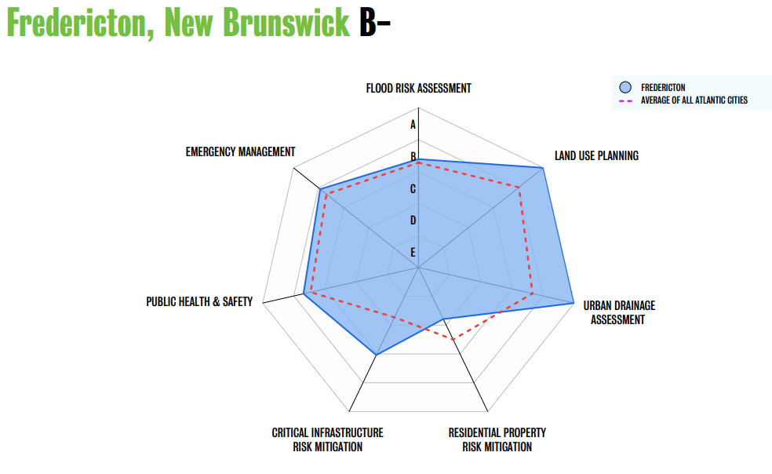
FLOOD PREPAREDNESS IN CITIES
Specific door-to-door
outreach already planned
for spring 2021!

Slide 19
AGENDA
1) Brief Introduction to the Intact Centre
2) Flooding in Canada
  Costs
  Impacts of climate change
  Scales of intervention
3) Strategic Action at the Basin Scale
  Flood risk management in Canada
  Emerging trends
  Flooding in New Brunswick
4) Resident Action at the Home Scale
  Impacts of flooding at the home level
  Addressing common flood risks at the lot level
  Higher risk properties
  Free resources available

Slide 20
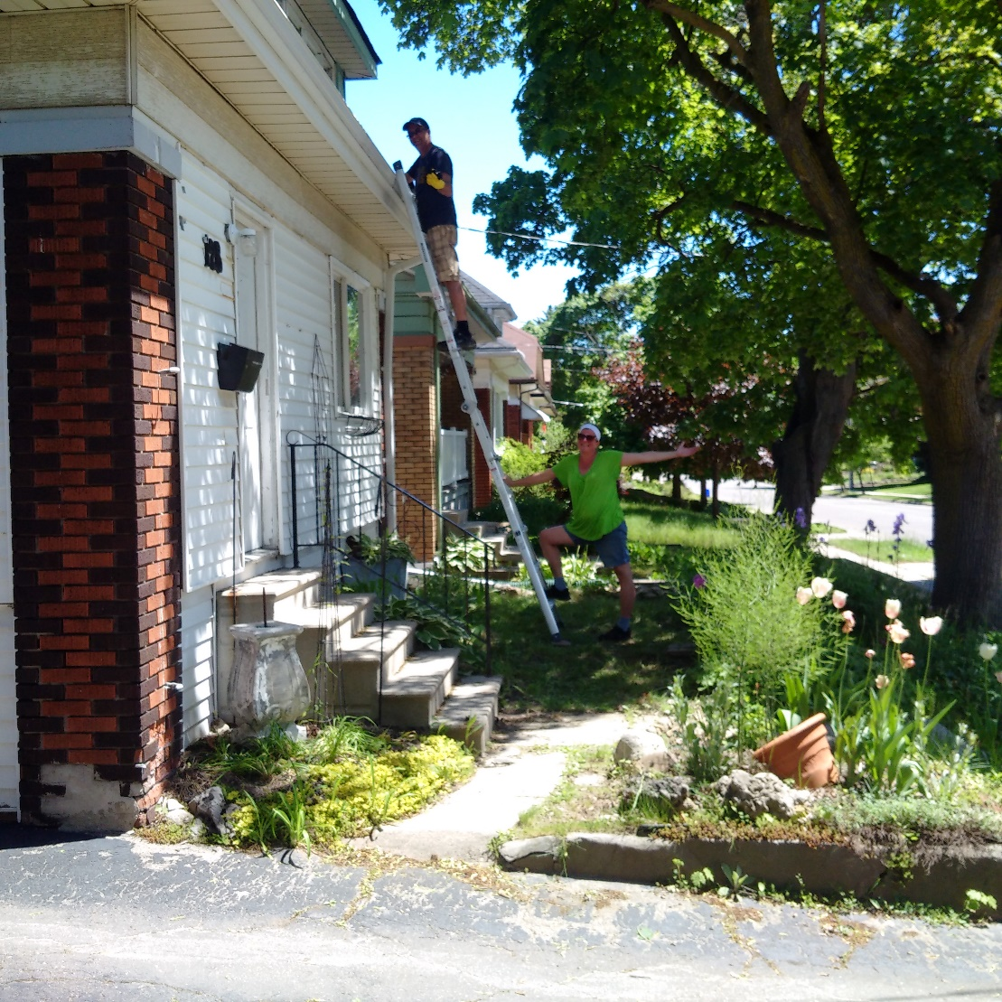
HOME WATER DAMAGE FAST FACTS
Did you know?
Water surpassed fire as Canada’s most common cause of insurance claims over 20 years ago
The majority (60%) of water claims are caused by leaking appliances and water pipes and the remainder are split between sewer back-ups, sump pump failure and overland flooding caused by heavy rainfall
All Canadian homes are at risk of flooding from the above risks
Roughly 5% of Canadian homes face additional risks due to overland flooding from rivers, lake and oceans
  Force exerted by moving water on walls and foundations
  Damage cause by collision of debris in moving water
  Property erosion

Slide 21
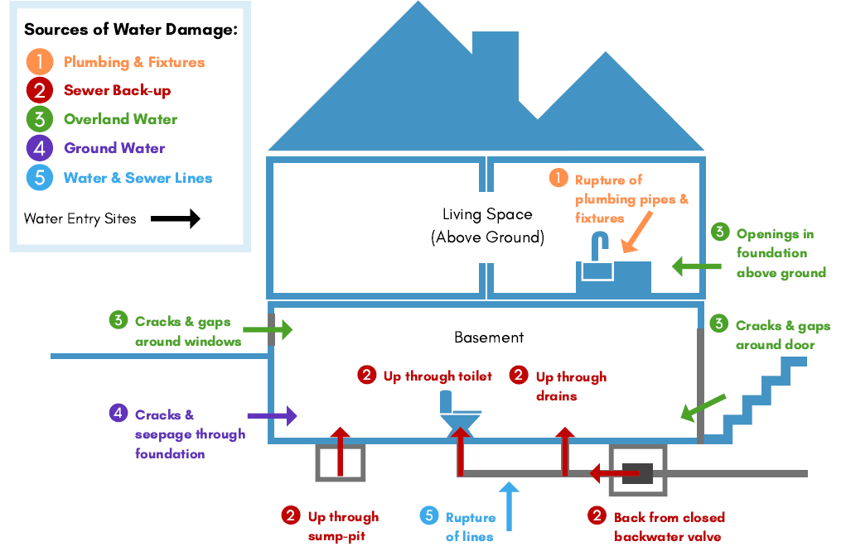
HOME FLOOD INSURANCE - FAST FACTS
Did You Know?
Wide availability- Water damage coverage for flooding caused by sudden and accidental leaks from plumbing and appliances is covered in all comprehensive homeowner policies
Limited availability- Depending on availability (optional) coverages may be purchased for
  Sewer backup flooding
  Overland flooding
  Groundwater flooding
  Flooding from water and sewer lines
Restoration coverage- Policies designed to restore former conditions not build back better
Denial- Claims may be denied due to
  Lack of regular maintenance
  Leaving your home unattended for more than a few days
Sources of Home Water Damage
Source: Intact Centre, 2019

Slide 22
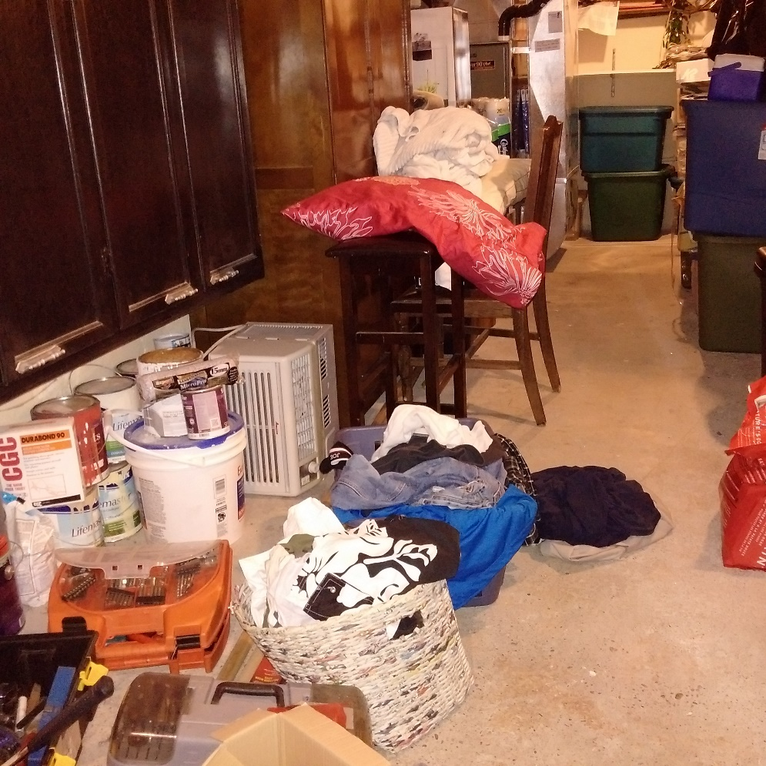
INTRODUCTION TO HOME FLOOD PROTECTION
Each home has unique lot level risks based on its
  Construction
  Condition
  Lot
  Location
  Contents
Lot level risks are influenced by community-level risks including
  Overland drainage systems
  Sewer systems
  Groundwater levels
  Proximity to rivers, lakes and oceans
Protecting each home is unique based on its lot-level and community level characteristics
Action taken to protect homes can reduce but not eliminate risk
Valuables and hazardous materials stored on a basement floor Source: Intact Centre, 2018

Slide 23
APPROACHES TO REDUCING RISK OF FLOOD DAMAGE AT THE LOT LEVEL
Which approach should be used?
Selecting the approach to assess and protect a building from flooding is based on
Type(s) of flooding
Severity of risk
Short and longer term risks
Approach | Flood Risk | Type of Actions | Level of Risk
Defend | Rainfall and Sewer Backup | Dry Flood Proofing Temporary Barriers | Lower Higher
Adapt | Riverine and Coastal | Wet Flood Proofing Temporary Barriers Elevate Buildings | High Higher Highest
Relocate | Riverine and Coastal | Relocate Buildings | Highest
DEFEND
ADAPT
RELOCATE

Slide 24
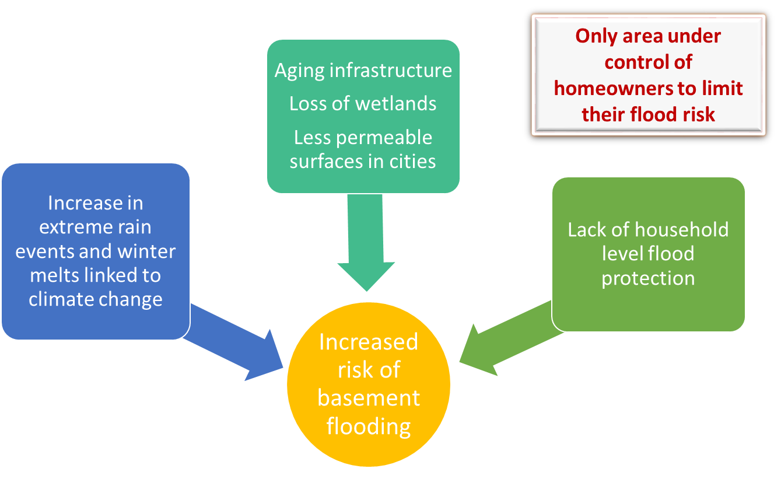
WHAT CAN RESIDENTS DO TO PROTECT THEIR HOMES?

Slide 25
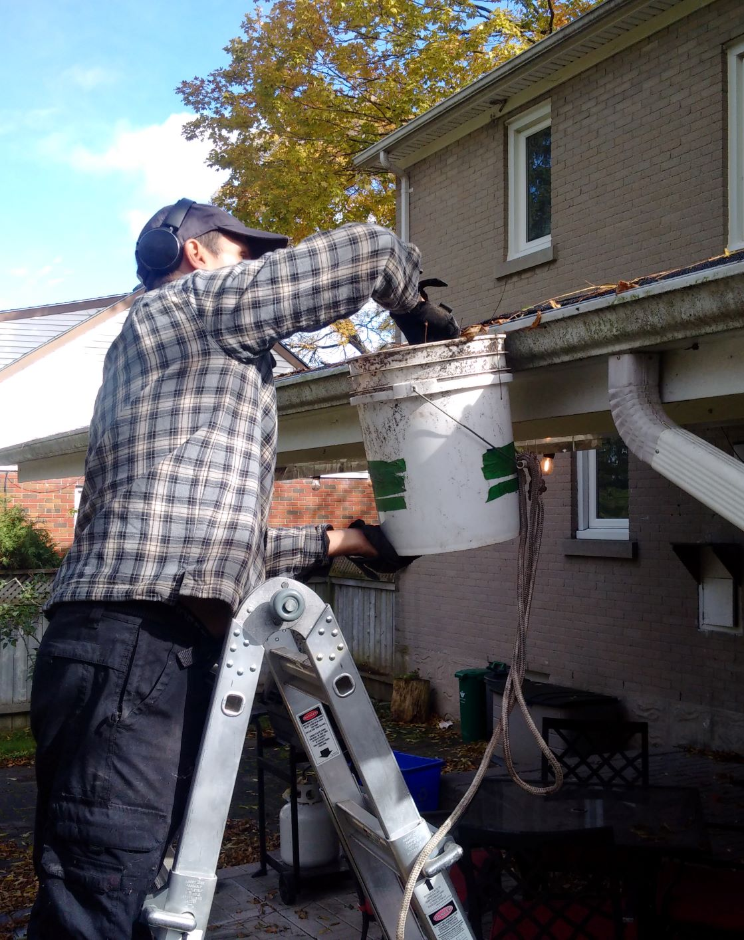
THE HOME FLOOD PROTECTION PROGRAM
Definition:
National flood risk reduction education program
Goals:
To help residents take action to reduce home flood risk and reduce damage in the event on a flood
Objectives:
Develop and test a variety of flood risk assessment tools, third-party outreach materials and stakeholder training programs
Achieve nation-wide impacts by training professionals such as home inspectors, insurance brokers, realtors, and retailers to support resident action to protect their homes from flooding

Slide 26
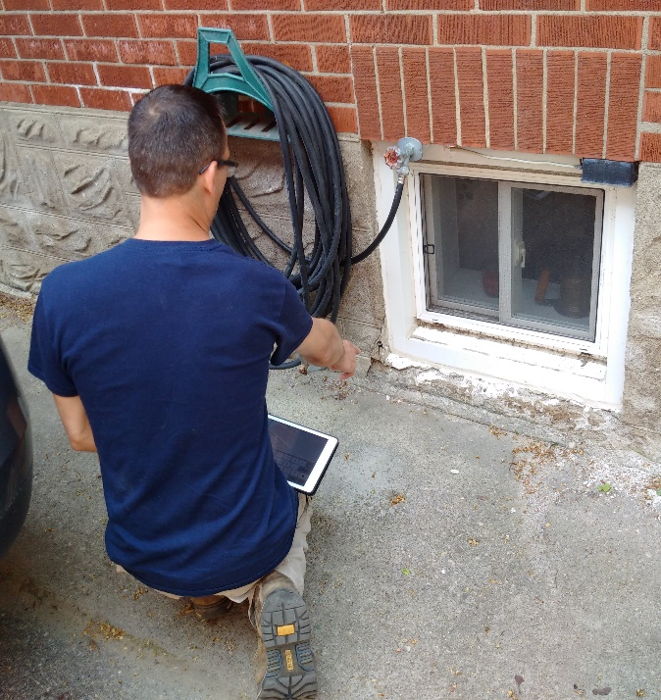
HOME FLOOD PROTECTION 101
Basic principles of home flood protection (dry flood proofing)
Keep water out
Remove it quickly if it gets in
Reduce risk of damage by selecting flood resistant
  Storage options
  Furnishings
  Building materials

Slide 27
UNDERSTANDING AND REDUCING RISK OF FLOOD DAMAGE AT THE LOT LEVEL
Which approach should be used?
Selecting the approach to assess and protect a building from flooding is based on
the type(s) of flooding
the severity of risk
Approach | Flood Risk | Type of Actions | Level of Risk
Defend | Rainfall and Sewer Backup | Dry Flood Proofing Temporary Barriers | Lower Higher
Adapt | Riverine and Coastal | Wet Flood Proofing Temporary Barriers Elevate Buildings | High Higher Highest
Relocate | Riverine and Coastal | Relocate Buildings | Highest
DEFEND
ADAPT
RELOCATE

Slide 28
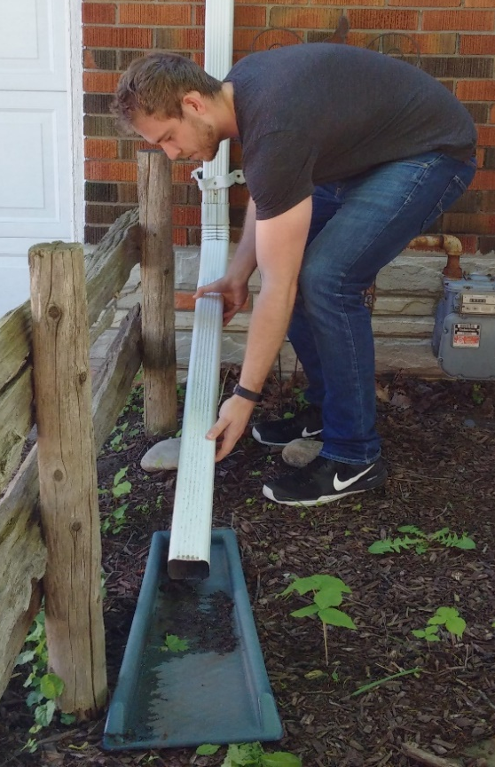
HOME FLOOD PROTECTION ASSESSMENTS
Pilot program of Intact Centre on Climate Adaptation 2017-2018 in Southern Ontario and Saskatoon, Saskatchewan
Completed 510 assessments and trained 15 flood risk assessors
Assessment protocols align with CSA Guideline on Flood Protection and Risk Reduction (CSA- Z800-18)
Assessment tool consists of a visual inspection of physical features inside and outside the home and recording maintenance practices as reported by the property owner
UW trained flood risk assessors engages homeowners in 60-90 minute site assessment and problem-solving conversation
Provide confidential report identifying flood risks, top actions to reduce risk, where further investigation required, links to additional resources
Resident extends his downspout after participating in an assessment, Waterloo, 2018

Slide 29
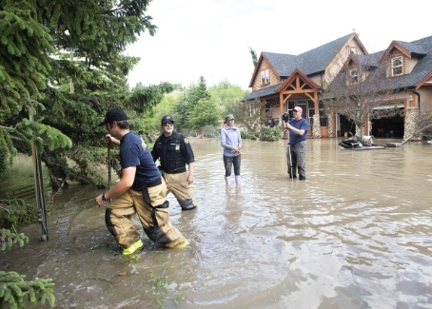
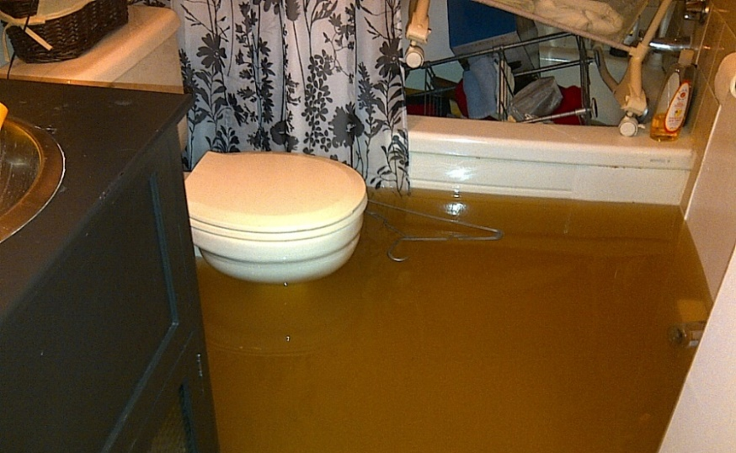
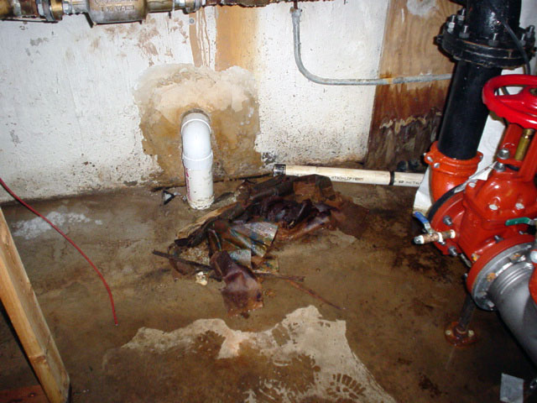
TYPES OF FLOODING ASSESSED
Education and training programs focus on 3 major flood types that impact municipalities
    Overland Flooding
    Storm/Sanitary Sewer Backup
    Groundwater Infiltration/Seepage
* Do not focus risks specific to riverine or coastal flooding although
SOURCE: Denette, The Canadian Press, 2013
SOURCE: Halifax Regional Municipality, 2019
SOURCE: Basement Systems Inc., 2011

Slide 30
TOP FLOOD RISKS AT ASSESSED HOMES
Notes:
Inverted Graph (Swap – Highest first, descending)

Slide 31
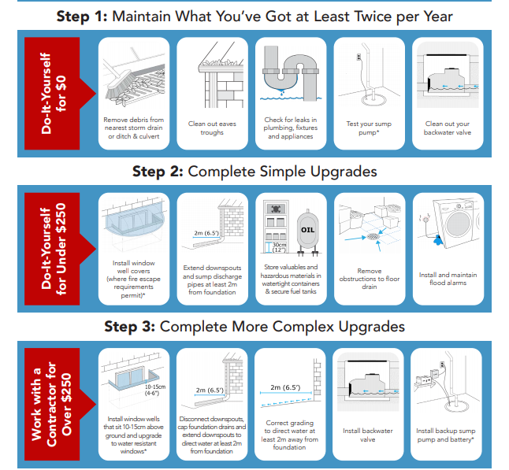
THREE STEPS TO COST-EFFECTIVE HOME FLOOD PROTECTION
What is the “Three Steps” infographic?
Action-focused infographic summarizing best practices by priority and cost
Priority #1 maintenance, #2 shorter term low cost actions, #3 longer term higher cost action
  English, French
  Share Tips Using Social Media
  Social media toolkit

Slide 32
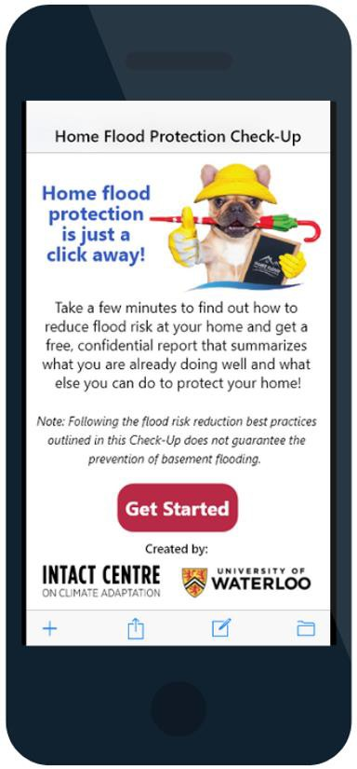

SIMPLE TOOL TO ASSESS AND REDUCE RISK OF FLOOD DAMAGE AT THE LOT LEVEL
16
What is the Home Flood Protection Check-Up?
The Home Flood Protection Check-up is a free, confidential, VISUAL home flood risk assessment tool developed by the Intact Centre on Climate Adaptation at the University of Waterloo.
Looks at the 15 most common flood risks to homes
Applicable to all Canadian homes
Does not include risks posed by river or coastal flooding
How can residents complete an assessment?
Click on the link in English (homefloodprotect.ca/checkup) or French (homefloodprotect.ca/fr)
Take 5-10 minutes to answer a series of yes or no questions
about flood risks inside and outside of the home
Have a confidential, custom home flood protection report emailed to you or download it onto your device

Slide 33
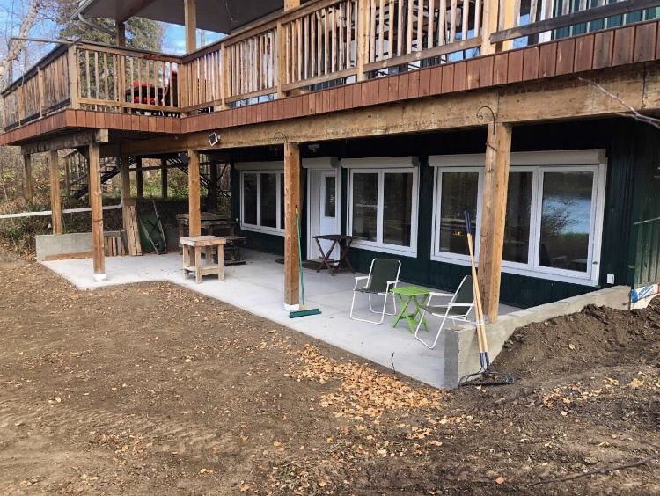
TEMPORARY FLOOD PROTECTION BARRIERS
What are they?
A physical barrier that is installed temporarily during an emergency situation
  Opening Barriers: Block water from entering an opening in a building (e.g. windows, doors, drains)
  Perimeter Barriers: Block water from flowing onto a property
When are temporary barriers used?
Installed ahead of flooding events caused by rainfall, riverine and coastal to reduce flood damages
Advance notice requirements vary widely because barrier installation times can range
  minutes (click-in door barriers)
  days (thousands of sandbags along waterfront properties)
Roll down temporary opening barriers installed at a riverside home, Edmonton, Alberta. Source: Guy Bridgeman, 2020

Slide 34
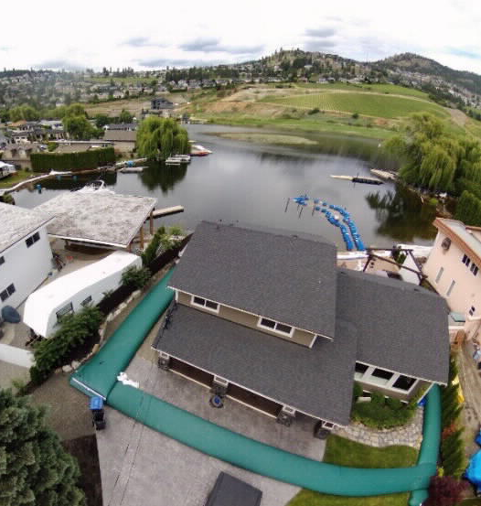
BEYOND DISPOSABLE SAND BAGS
Disposable Options (Sandbags)
Pros
  Lower one time cost
  Relatively simple to install
Cons
  Labour intensive
  Must be disposed of as hazardous material
  If sand if salted may damage plant and animal life
  Effective in only limited situations
  May be more expensive in the long term
Reusable Options (Sandless sandbags, molded plastic blocks and panels, flat panel walls, plastic tubing)
Pros
  Effective in wider variety of applications
  May save money over the longer term
Cons
  Consultation with professionals is recommended
  Higher initial cost
  Storage requirements
Plastic tubing perimeter barrier around a home Source: Swan, 2020

Slide 35
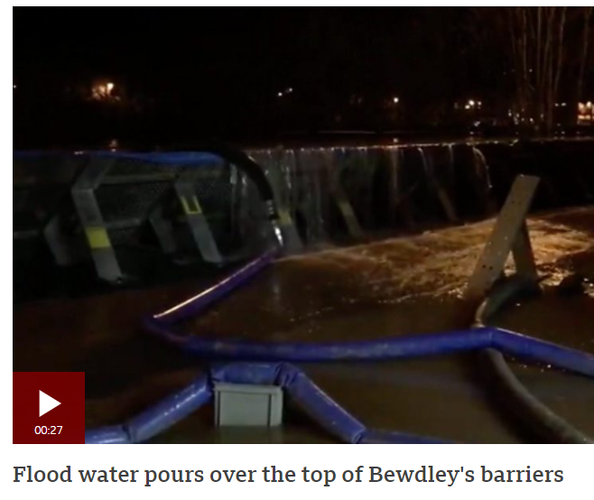
TEMPORARY BARRIERS ARE TEMPORARY SOLUTIONS
Flood Water Breaches River Barrier in UK
Shorter term, temporary solutions
Should be designed and installed with the support of a qualified professional(s) to
To reduce risk of failure considerations should include
  Type of bearing soil (if applicable) that surface barriers will be deployed on
  Potential for soil erosion affecting the barrier placement
  Characteristics of the floodwaters expected
    Potential for wave action
    Potential for wind
    Potential for movement of debris
Source: BBC News, Feb 2020

Slide 36
REDUCING RISK OF FLOOD DAMAGE AT THE LOT LEVEL IN HIGHER RISK LOCATIONS
Key Considerations
Short and long term risks
Budget
Insurance availability
Government buyout options
Common Requirements
Consultation with government officials and qualified professionals
Government permits
Approach | Flood Risk | Type of Actions | Level of Risk
Defend | Rainfall and Sewer Backup | Dry Flood Proofing Temporary Barriers | Lower Higher
Adapt | Riverine and Coastal | Wet Flood Proofing Temporary Barriers Elevate Buildings | High Higher Highest
Relocate | Riverine and Coastal | Relocate Buildings | Highest
DEFEND
ADAPT
RELOCATE

Slide 37
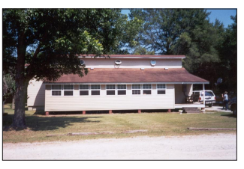
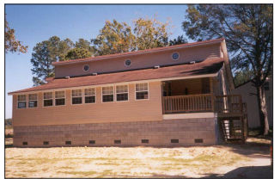
LOWER ST JOHN RIVER CASE STUDY
Wet Flood Proofing Option Featuring Vented, Raised Foundation
Who?
Keith and Roberta MacKenzie, ages 80 and 83 respectively
Where?
Home beside the lower St John River, near Gagetown, NB
What Happened?
Major river flood damage 2008 (insurance), 2018 (no insurance), 2019 (insured)
Solutions
Cleanup and repair of original structure for 2008 and 2018
2019 raised original 4’ crawl space foundation to 8’ vented masonry blockage foundation
Vent holes allow water to flow through
Outlook
Pro- Peace of mind from investing in the longer term solution
Con- Big personal debt load
Before
After
Source: Homeowner’s Guide to Retrofitting, FEMA, 2014

Slide 38

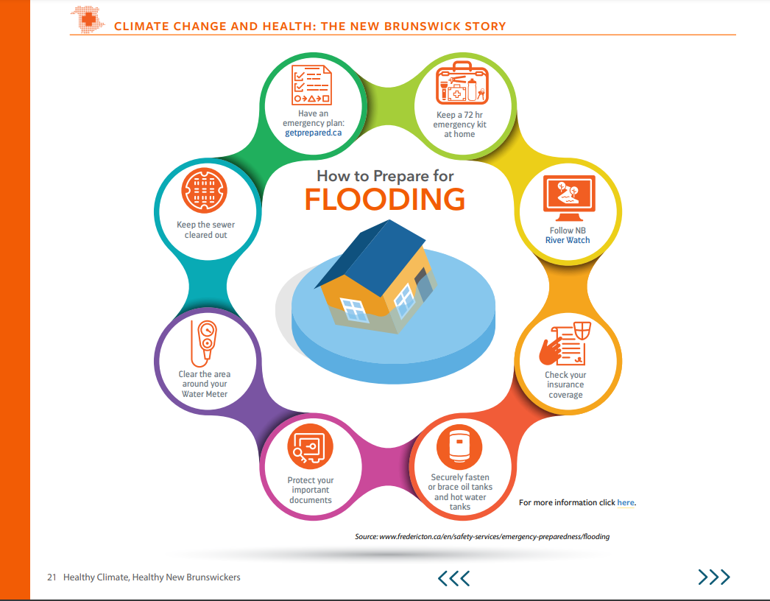
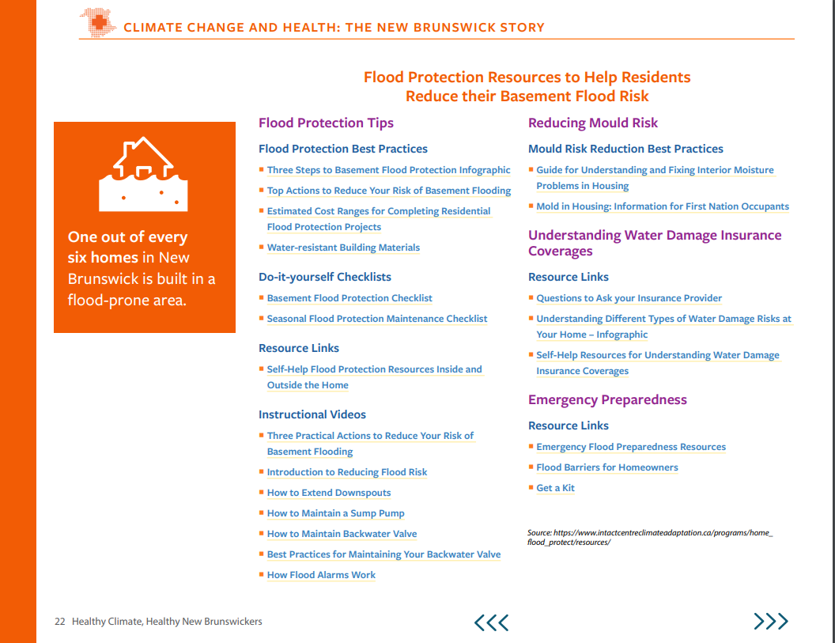
NEW BRUNSWICK RESOURCES
Find out more!
https://www.conservationcouncil.ca/wp-content/uploads/2020/03/Flood-prep-ccreport.pdf

Slide 39
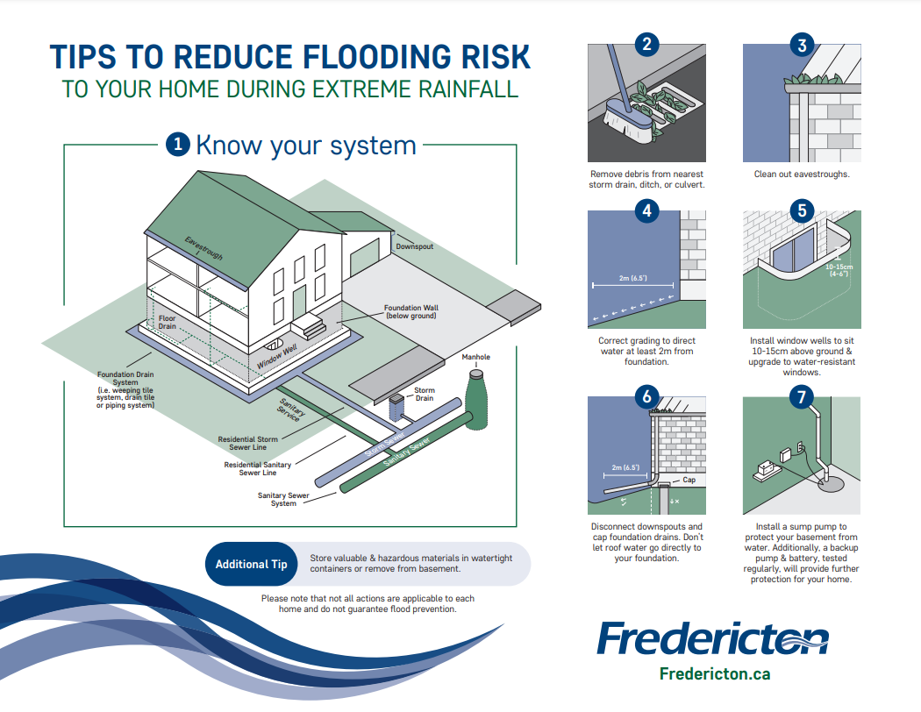
NEW BRUNSWICK RESOURCES - FREDERICTON
July / August 2020 - Community Conversations On Flood Mitigation And Resiliency
Development of resources to help homeowners take action themselves.
Part of package to be hand delivered by Fire Department staff in 2021
Additional issues:
  New Brunswick needs stronger rules to protect watersheds.
  Deforestation on land near waterways contributes to flooding and needs to be addressed.

Slide 40
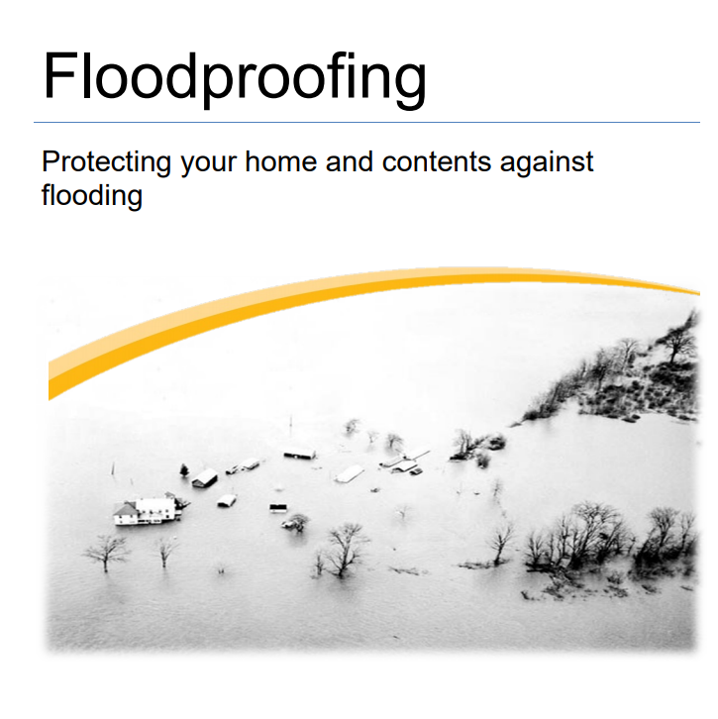
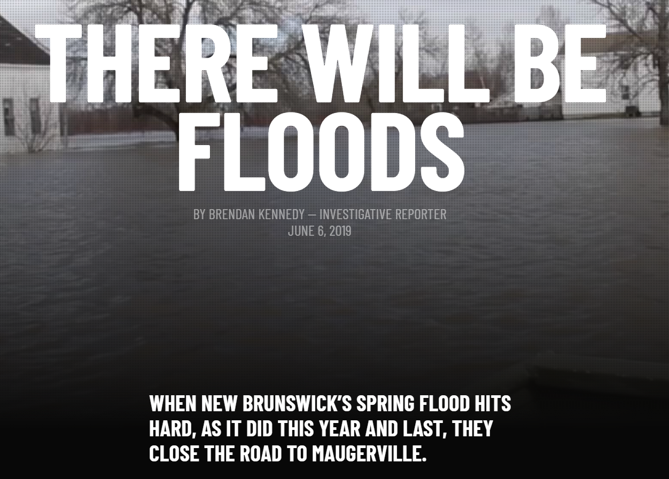
NEW BRUNSWICK RESOURCES
Government of New Brunswick
https://www2.gnb.ca/content/dam/gnb/Departments/env/pdf/Flooding-Inondations/Floodproofing.pdf
Personal flood stories from New Brunswick in The Toronto Star
https://projects.thestar.com/climate-change-canada/new-brunswick/

Slide 41
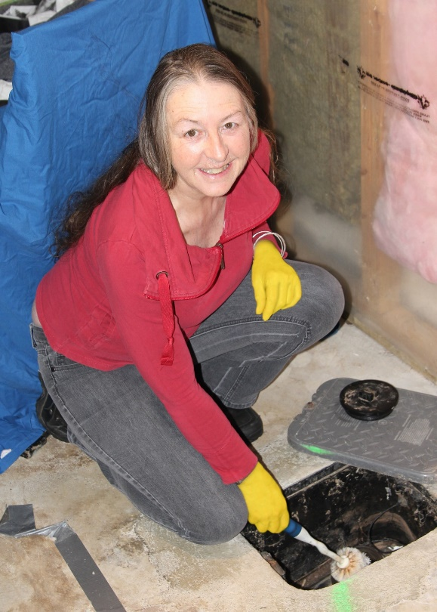
ADDITIONAL RESOURCES
www.HomeFloodProtect.ca
Flood Protection Fact Sheets and How-to Videos
Flood Risk Self-Assessment Tool
Flood Protection Training
Mould Risk Reduction Resources
Temporary Flood Protection Barrier Resources
Shareable Social Media Content
  Twitter @ICCA_Canada
  Facebook @HomeFloodProtect
  Social media toolkit
  Additional Information
Cheryl Evans Joanna Eyquem
c8evans@uwaterloo.ca joanna.eyquem@uwaterloo.ca
Homeowner Margaret Banks demonstrates how to clean a backwater valve, 2017

